Slide 1
Applying AI with Python
Alex Conway
alex@numberboost.com

Slide 2
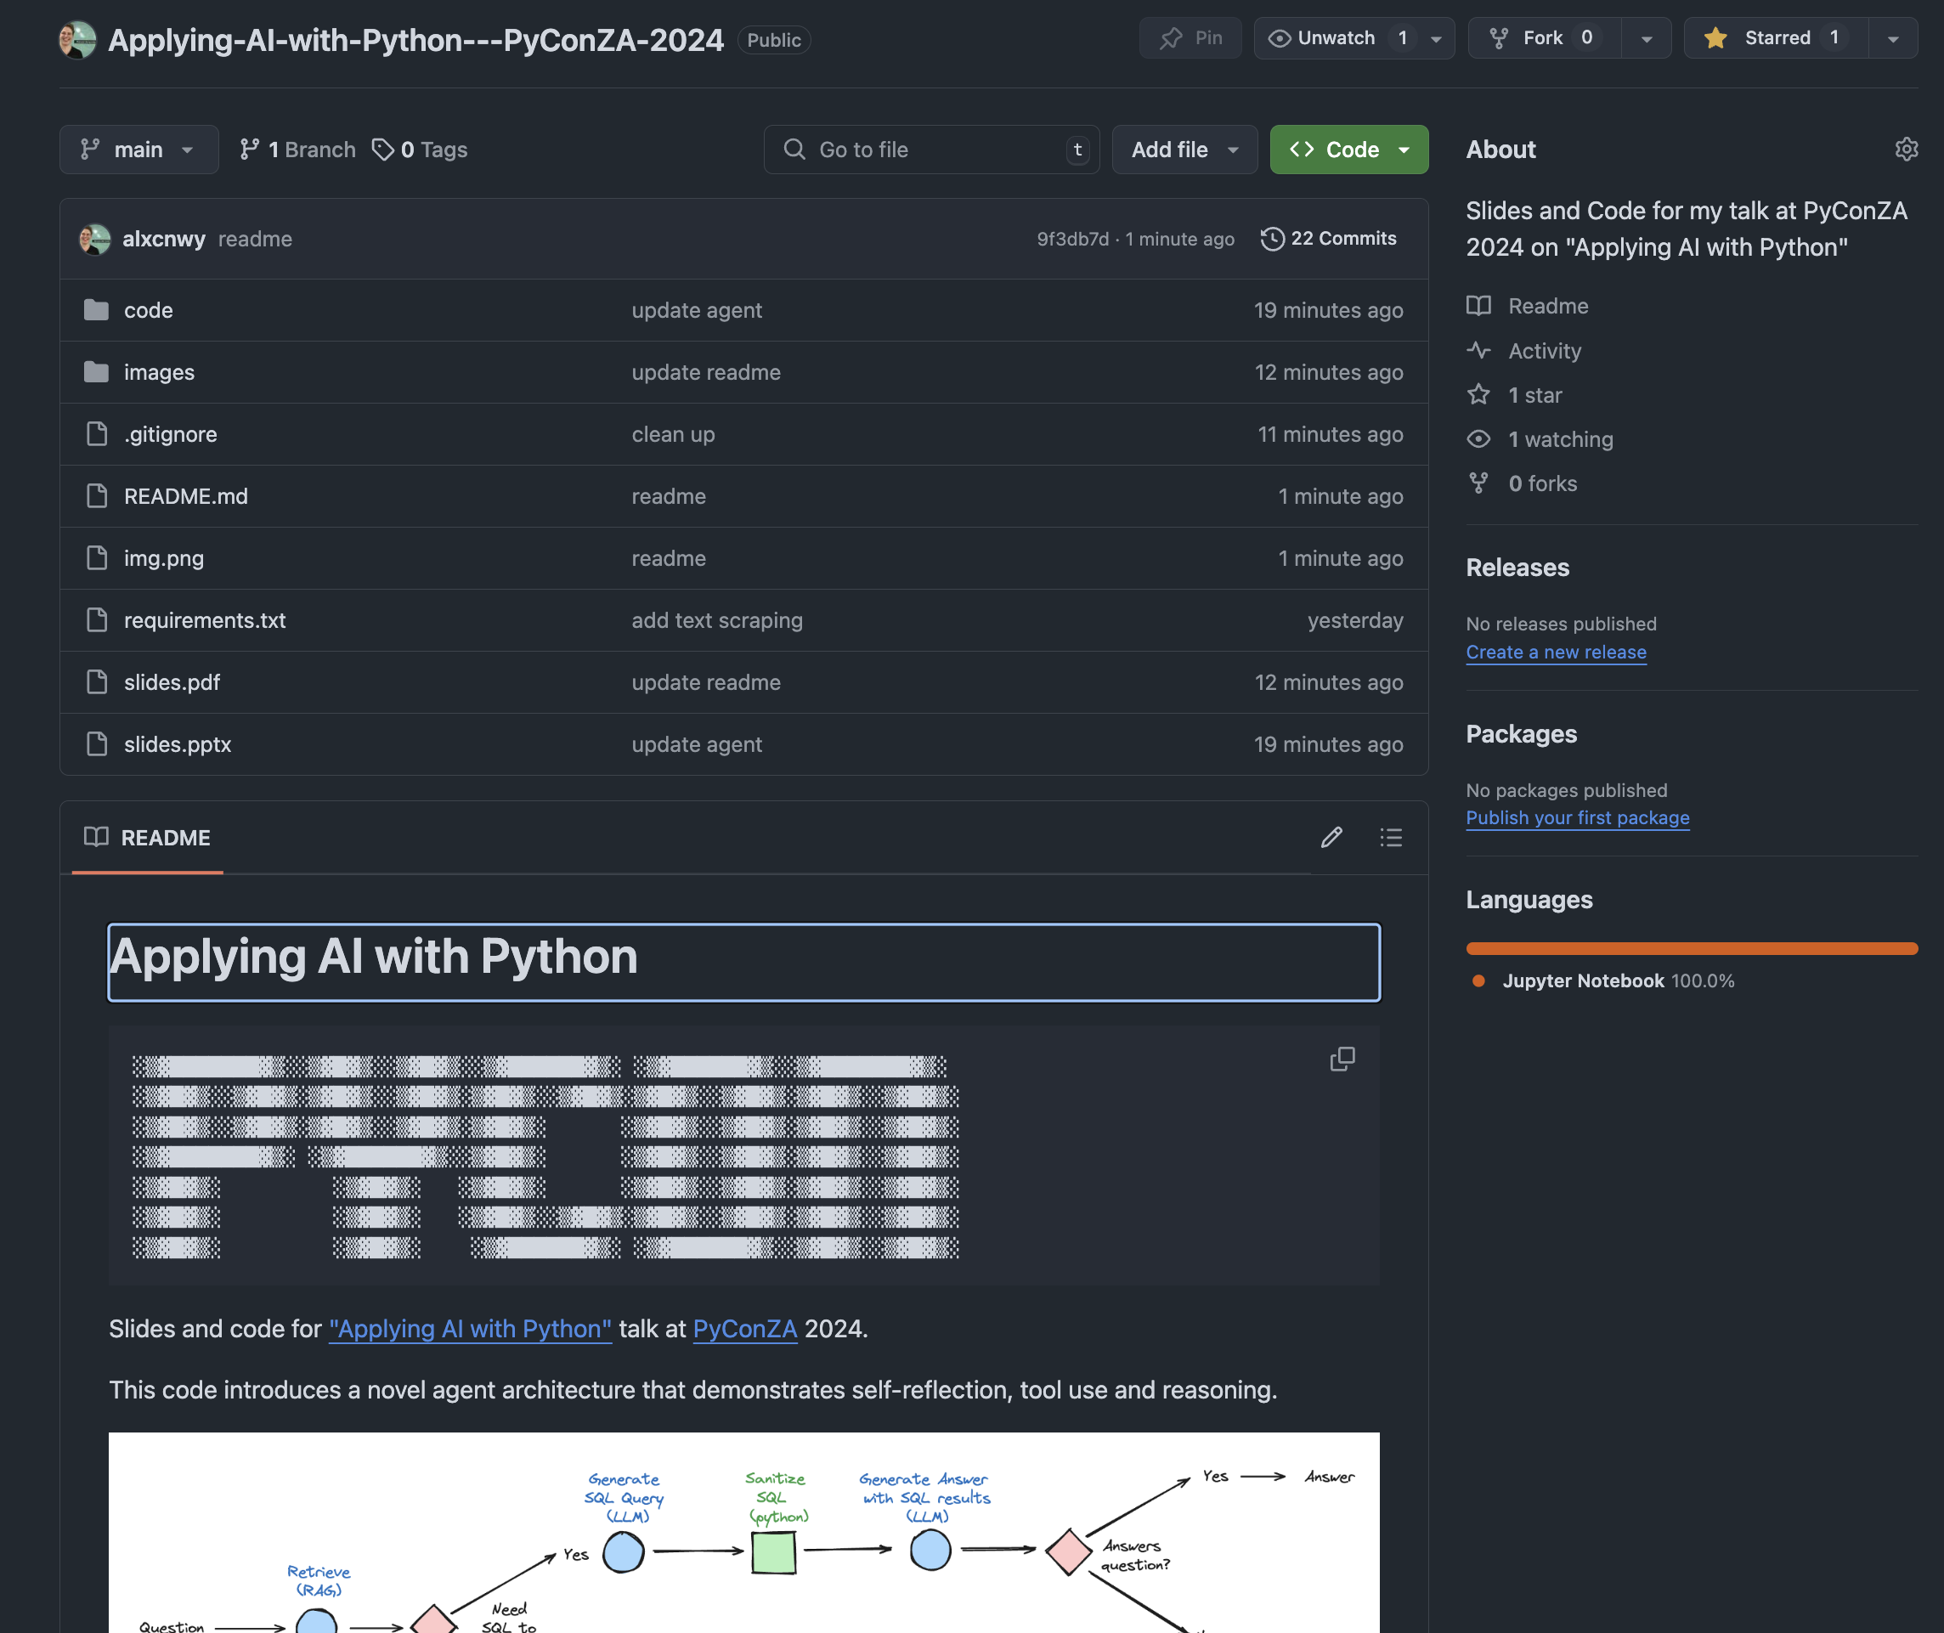

Slide 3

github.com/alxcnwy/applying-ai-with-python

Slide 4
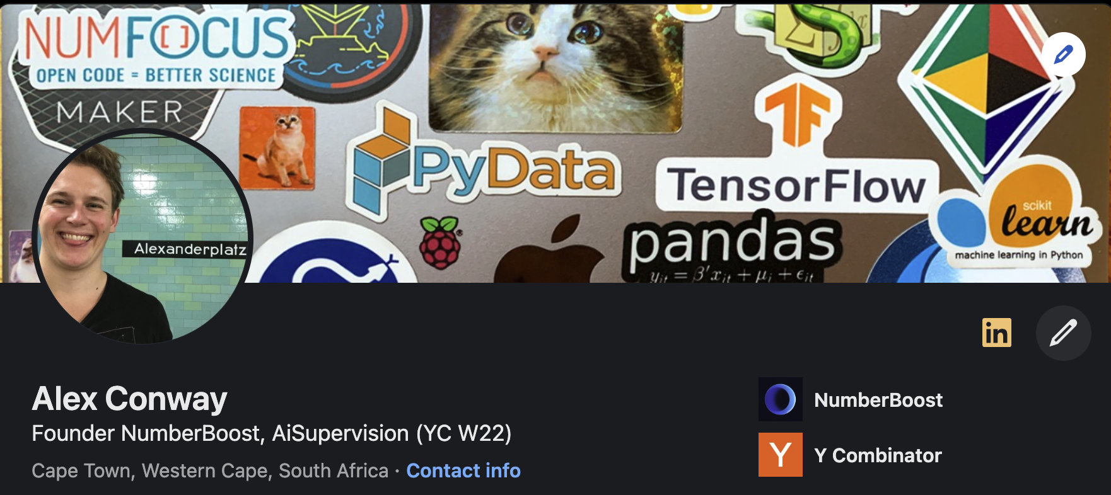
x.com/alxcnwy linkedin.com/in/alxcnwy/

Slide 5
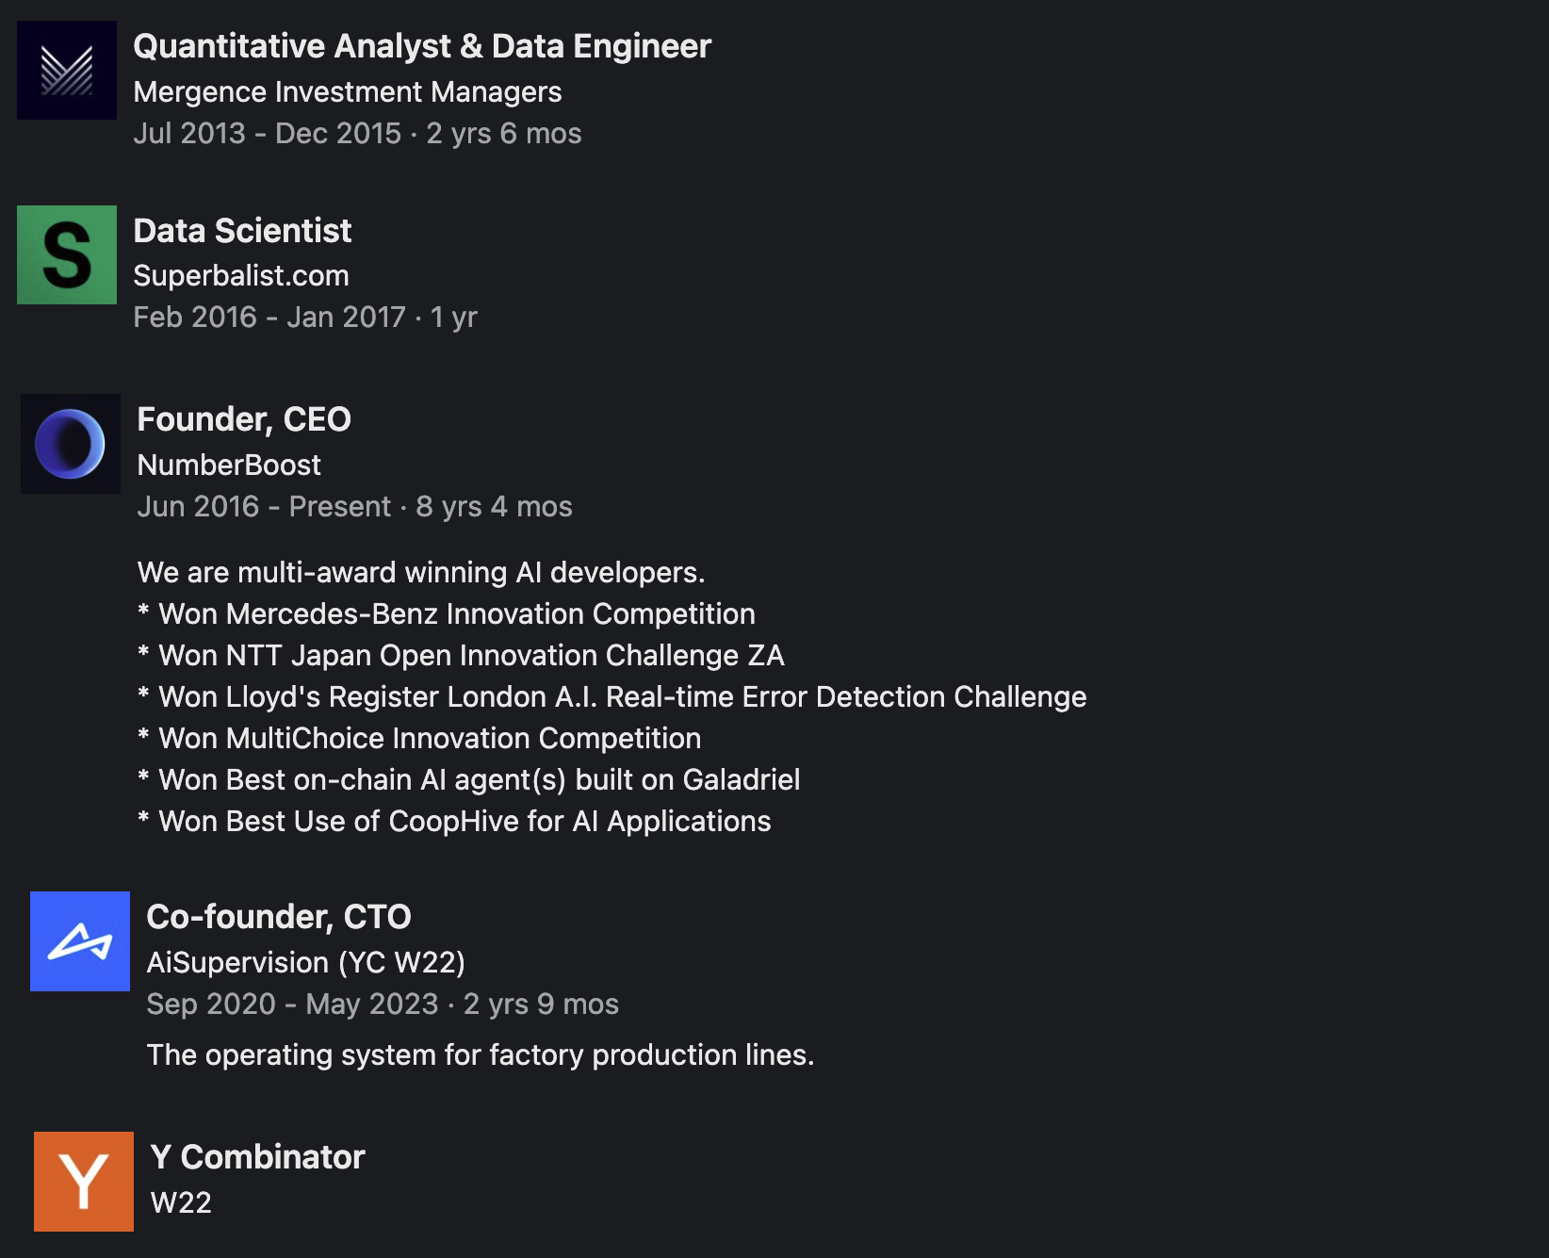

Slide 6
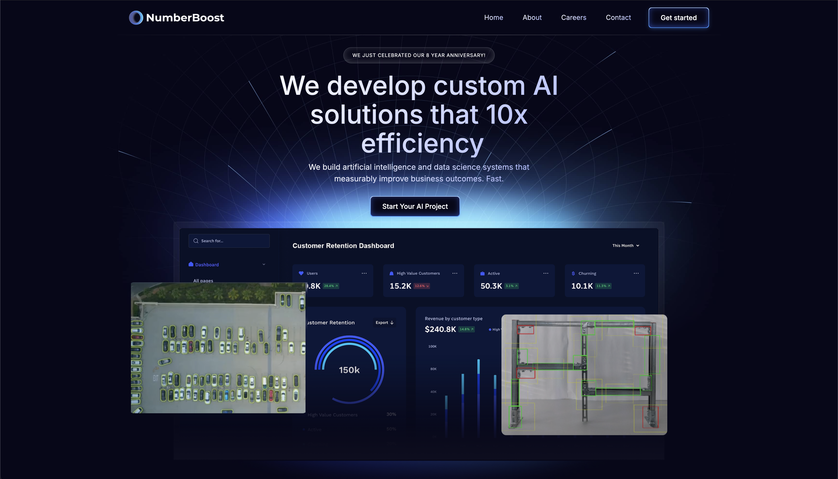

Slide 7

What is Artificial Intelligence (AI)?

Slide 8
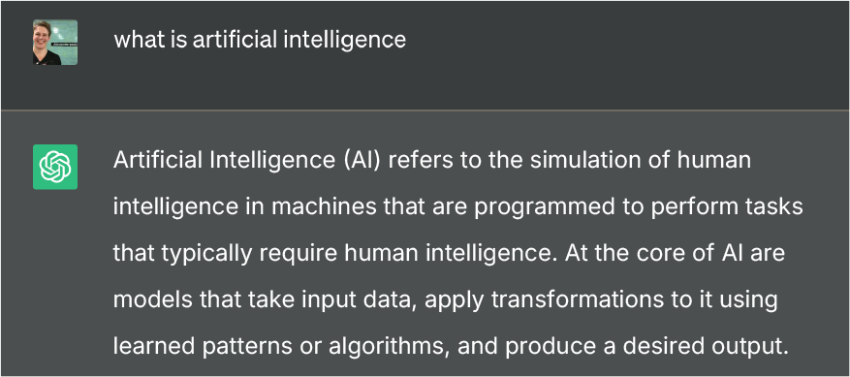

Slide 10

def ai_model(input):
#
# algorithms f(input) = output
#
return output

Slide 11
def ai_model(input):
#
# algorithms f(input) = output
#
return output

Slide 12
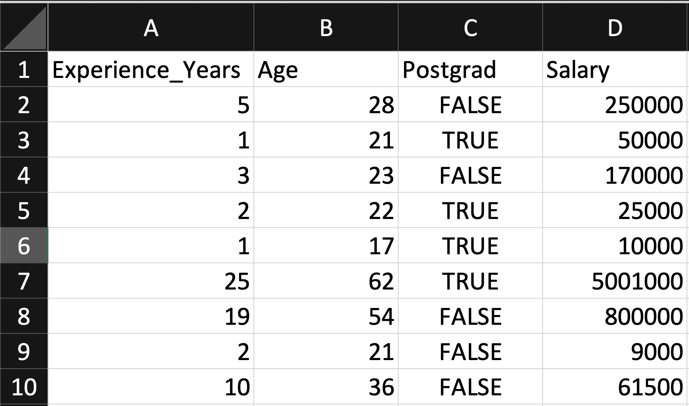
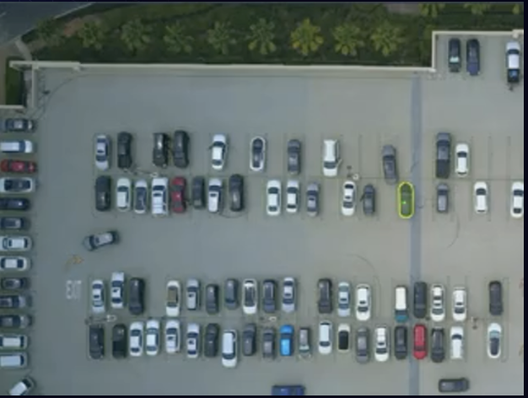
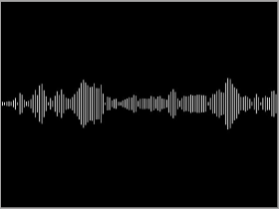
Input
Table
Image / Video
Artificial Intelligence (AI) is transforming industries and our lives by enabling computers to solve increasingly complex tasks, and Python stands at the forefront of this revolution. In this talk, we will explore how Python's rich ecosystem of AI libraries and frameworks can be harnessed to
Text
Audio

Slide 13
def ai_model(input):
#
# algorithms f(input) = output
#
return output

Slide 14
Algorithm Terminology
(Supervised) Regression (predict a number)
(Supervised) Classification (predict a category / label)
Unsupervised (find patterns within a dataset without labels)
Generative (create new data / content)

Slide 15
Types of AI Algorithms
Regression (Linear / Polynomial / Logistic, etc.)
Decision Trees (Random Forests, GBMs, etc.)
Clustering (K-Means, Spectral, DBSCAN, etc.)
Neural Networks (Convolutional, Recurrent, Transformer, etc.)
And more…

Slide 16
def ai_model(input):
#
# algorithms f(input) = output
#
return output

Slide 17
Output
Table
Image / Video
Artificial Intelligence (AI) is transforming industries and our lives by enabling computers to solve increasingly complex tasks, and Python stands at the forefront of this revolution. In this talk, we will explore how Python's rich ecosystem of AI libraries and frameworks can be harnessed to
Text
Audio

Slide 18
Output
Table
Image / Video
Artificial Intelligence (AI) is transforming industries and our lives by enabling computers to solve increasingly complex tasks, and Python stands at the forefront of this revolution. In this talk, we will explore how Python's rich ecosystem of AI libraries and frameworks can be harnessed to
Text
Audio

Slide 19
Output
Table
Image / Video
Artificial Intelligence (AI) is transforming industries and our lives by enabling computers to solve increasingly complex tasks, and Python stands at the forefront of this revolution. In this talk, we will explore how Python's rich ecosystem of AI libraries and frameworks can be harnessed to
Text
Audio

Slide 20
Output
Table
Image / Video
Artificial Intelligence (AI) is transforming industries and our lives by enabling computers to solve increasingly complex tasks, and Python stands at the forefront of this revolution. In this talk, we will explore how Python's rich ecosystem of AI libraries and frameworks can be harnessed to
Text
Audio

Slide 21
Output
Table
Image / Video
Artificial Intelligence (AI) is transforming industries and our lives by enabling computers to solve increasingly complex tasks, and Python stands at the forefront of this revolution. In this talk, we will explore how Python's rich ecosystem of AI libraries and frameworks can be harnessed to
Text
Audio

Slide 22
Output
Table
Image / Video
Artificial Intelligence (AI) is transforming industries and our lives by enabling computers to solve increasingly complex tasks, and Python stands at the forefront of this revolution. In this talk, we will explore how Python's rich ecosystem of AI libraries and frameworks can be harnessed to
Text
Audio

Slide 23
Output
Table
Image / Video
Artificial Intelligence (AI) is transforming industries and our lives by enabling computers to solve increasingly complex tasks, and Python stands at the forefront of this revolution. In this talk, we will explore how Python's rich ecosystem of AI libraries and frameworks can be harnessed to
Text
Audio

Slide 24
Output
Table
Image / Video
Artificial Intelligence (AI) is transforming industries and our lives by enabling computers to solve increasingly complex tasks, and Python stands at the forefront of this revolution. In this talk, we will explore how Python's rich ecosystem of AI libraries and frameworks can be harnessed to
Text
Audio

Slide 25
Output
Table
Image / Video
Artificial Intelligence (AI) is transforming industries and our lives by enabling computers to solve increasingly complex tasks, and Python stands at the forefront of this revolution. In this talk, we will explore how Python's rich ecosystem of AI libraries and frameworks can be harnessed to
Text
Audio

Slide 26
Output
Table
Image / Video
Artificial Intelligence (AI) is transforming industries and our lives by enabling computers to solve increasingly complex tasks, and Python stands at the forefront of this revolution. In this talk, we will explore how Python's rich ecosystem of AI libraries and frameworks can be harnessed to
Text
Audio

Slide 27




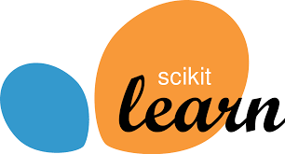



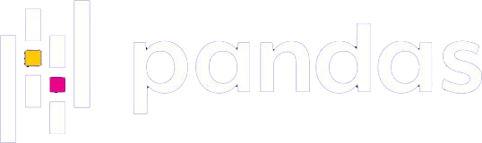
Why Python for AI?
Easy to use (ML researchers typically not software engineers)
Massive community (easy to find answers to questions)
Extensive libraries and frameworks (don’t need to invent to use)

Slide 28
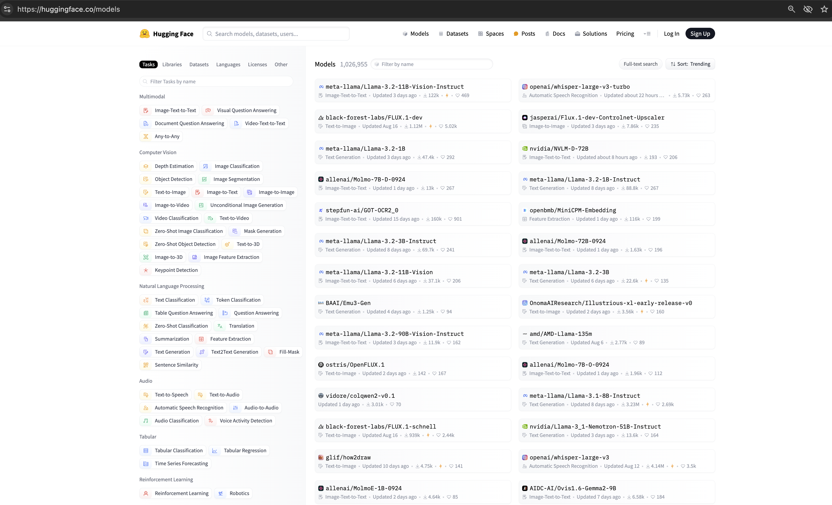

Slide 29
Image/
Video
Text
Audio
Table

Slide 30
Table Data

Slide 31
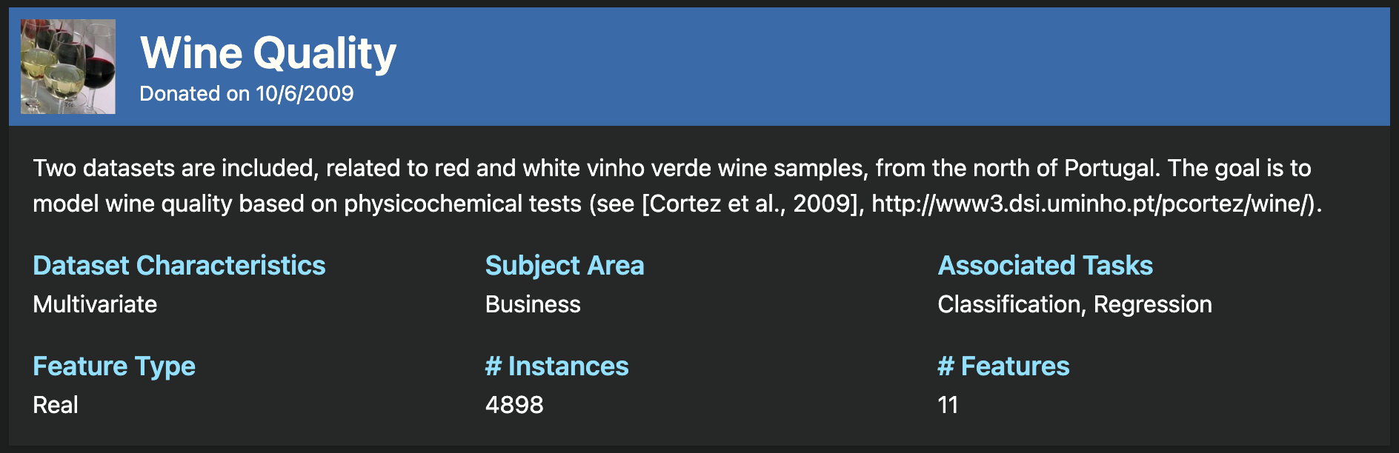
https://archive.ics.uci.edu/dataset/186/wine+quality

Slide 32
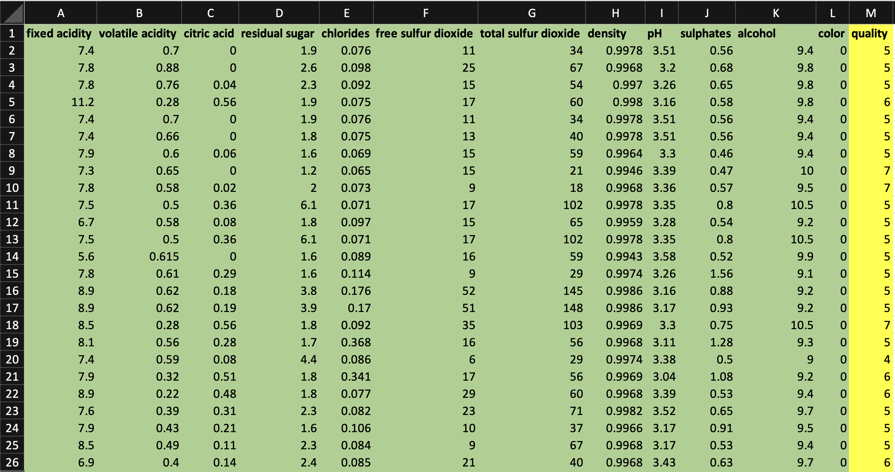
Regression Model
to Predict Wine Quality

Slide 33
Jupyter Notebook
TableData.ipynb

Slide 34
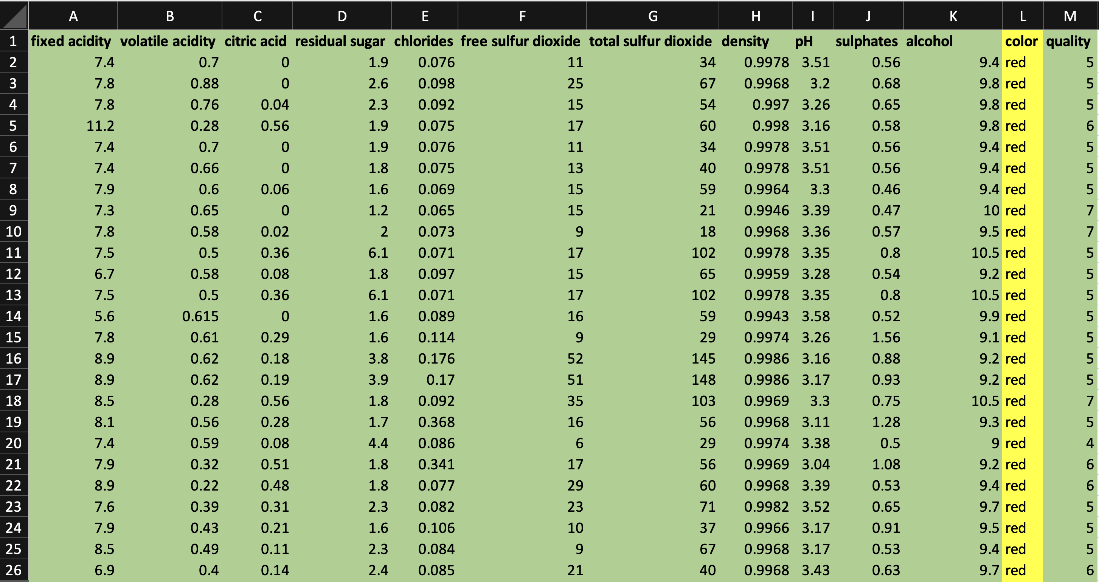
Classification Model
to Predict Wine Colour

Slide 35
Jupyter Notebook
TableData.ipynb

Slide 36
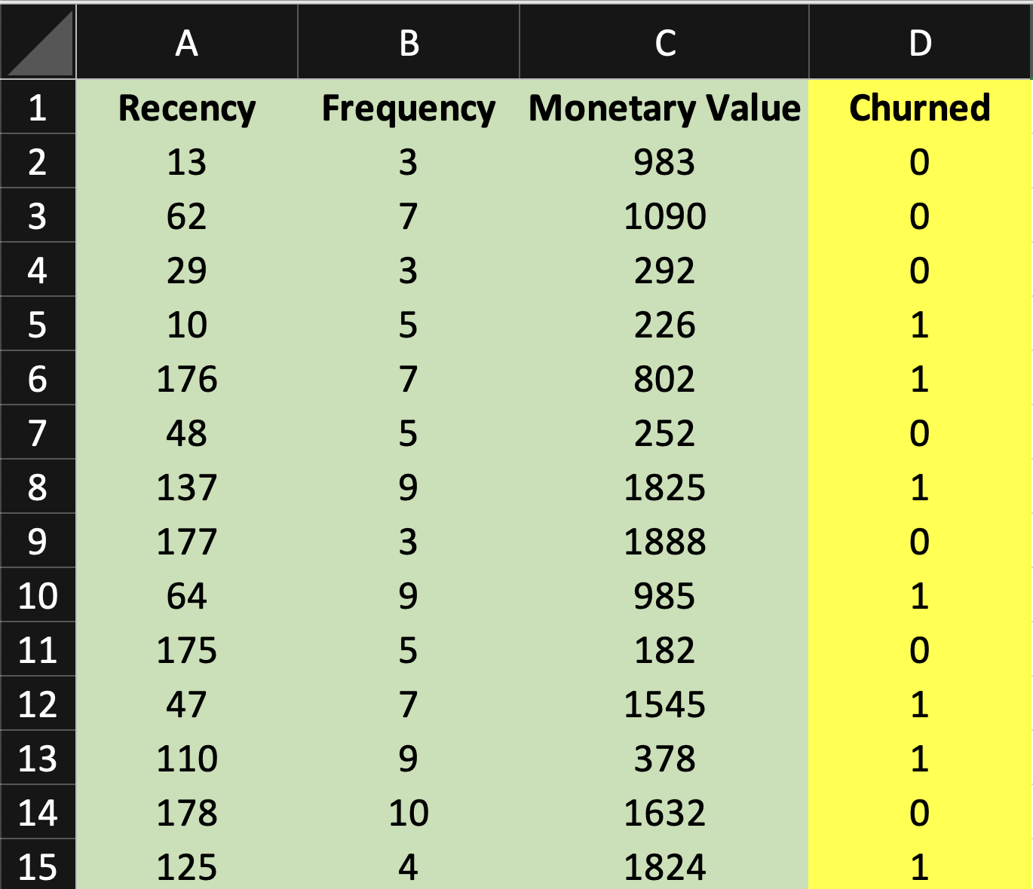

Slide 37

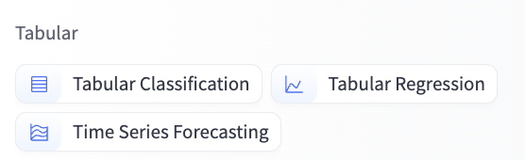

Slide 38
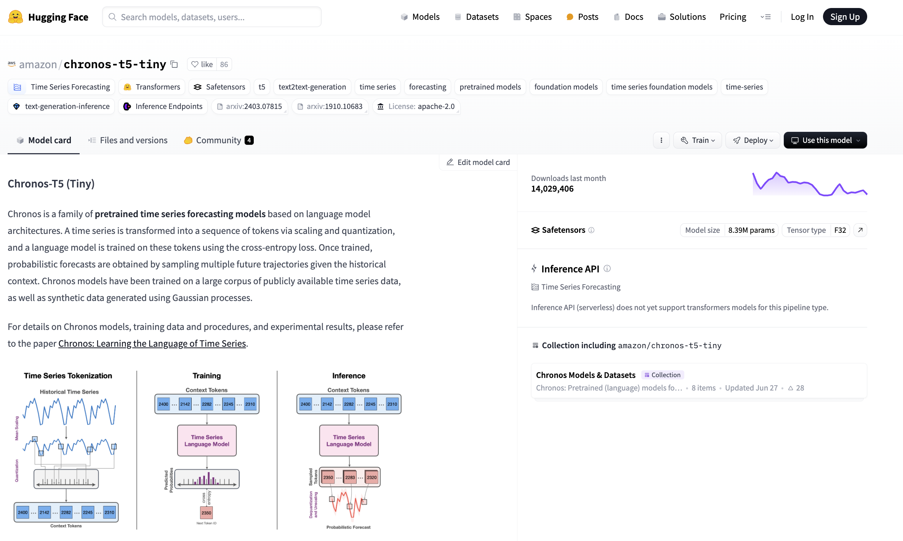

Slide 39
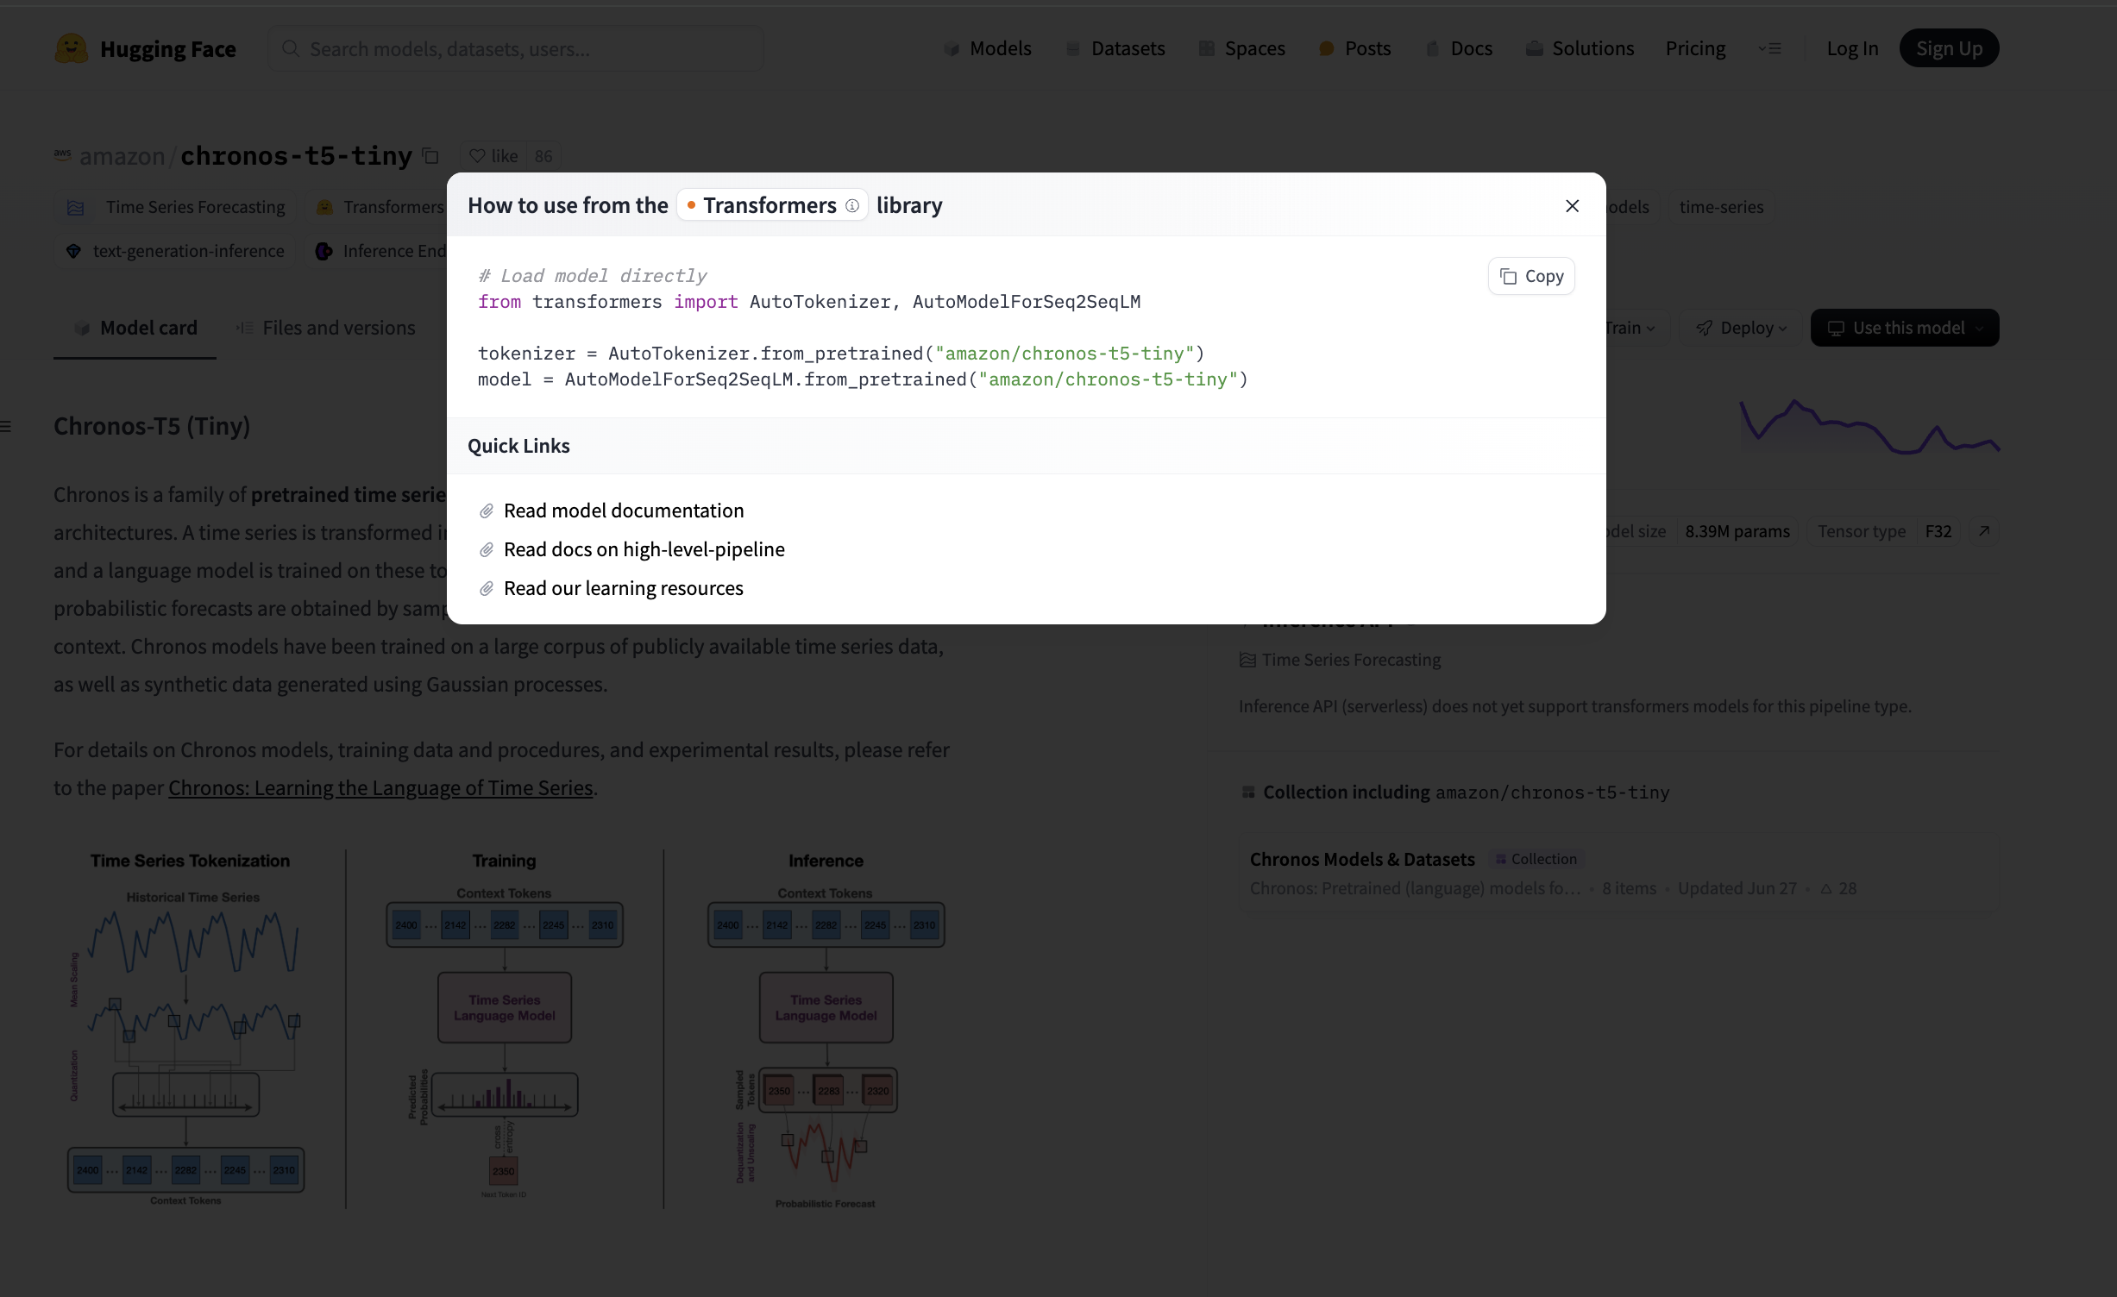

Slide 40
Image / Video Data

Slide 41
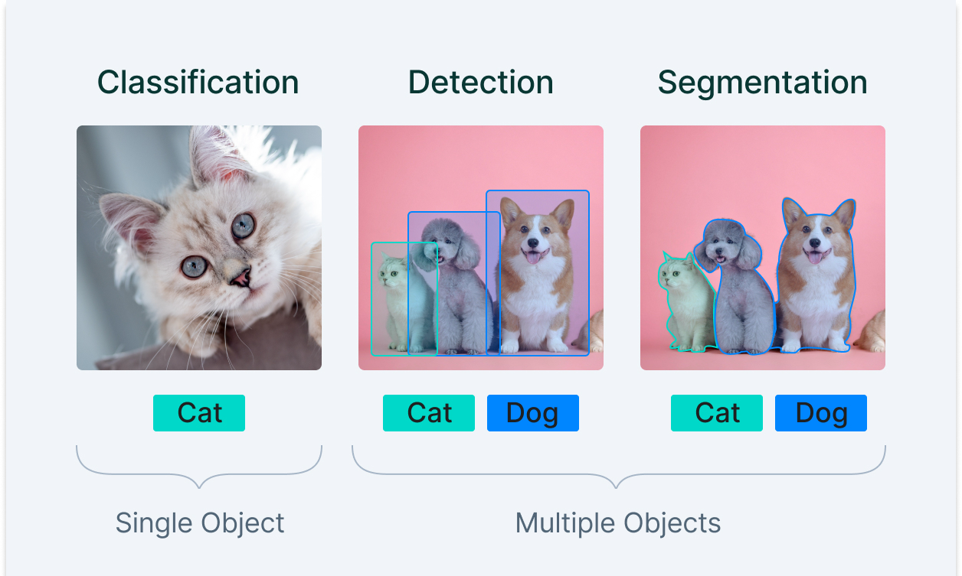

Slide 42
Jupyter Notebook
Classification and Visual Search.ipynb

Slide 43
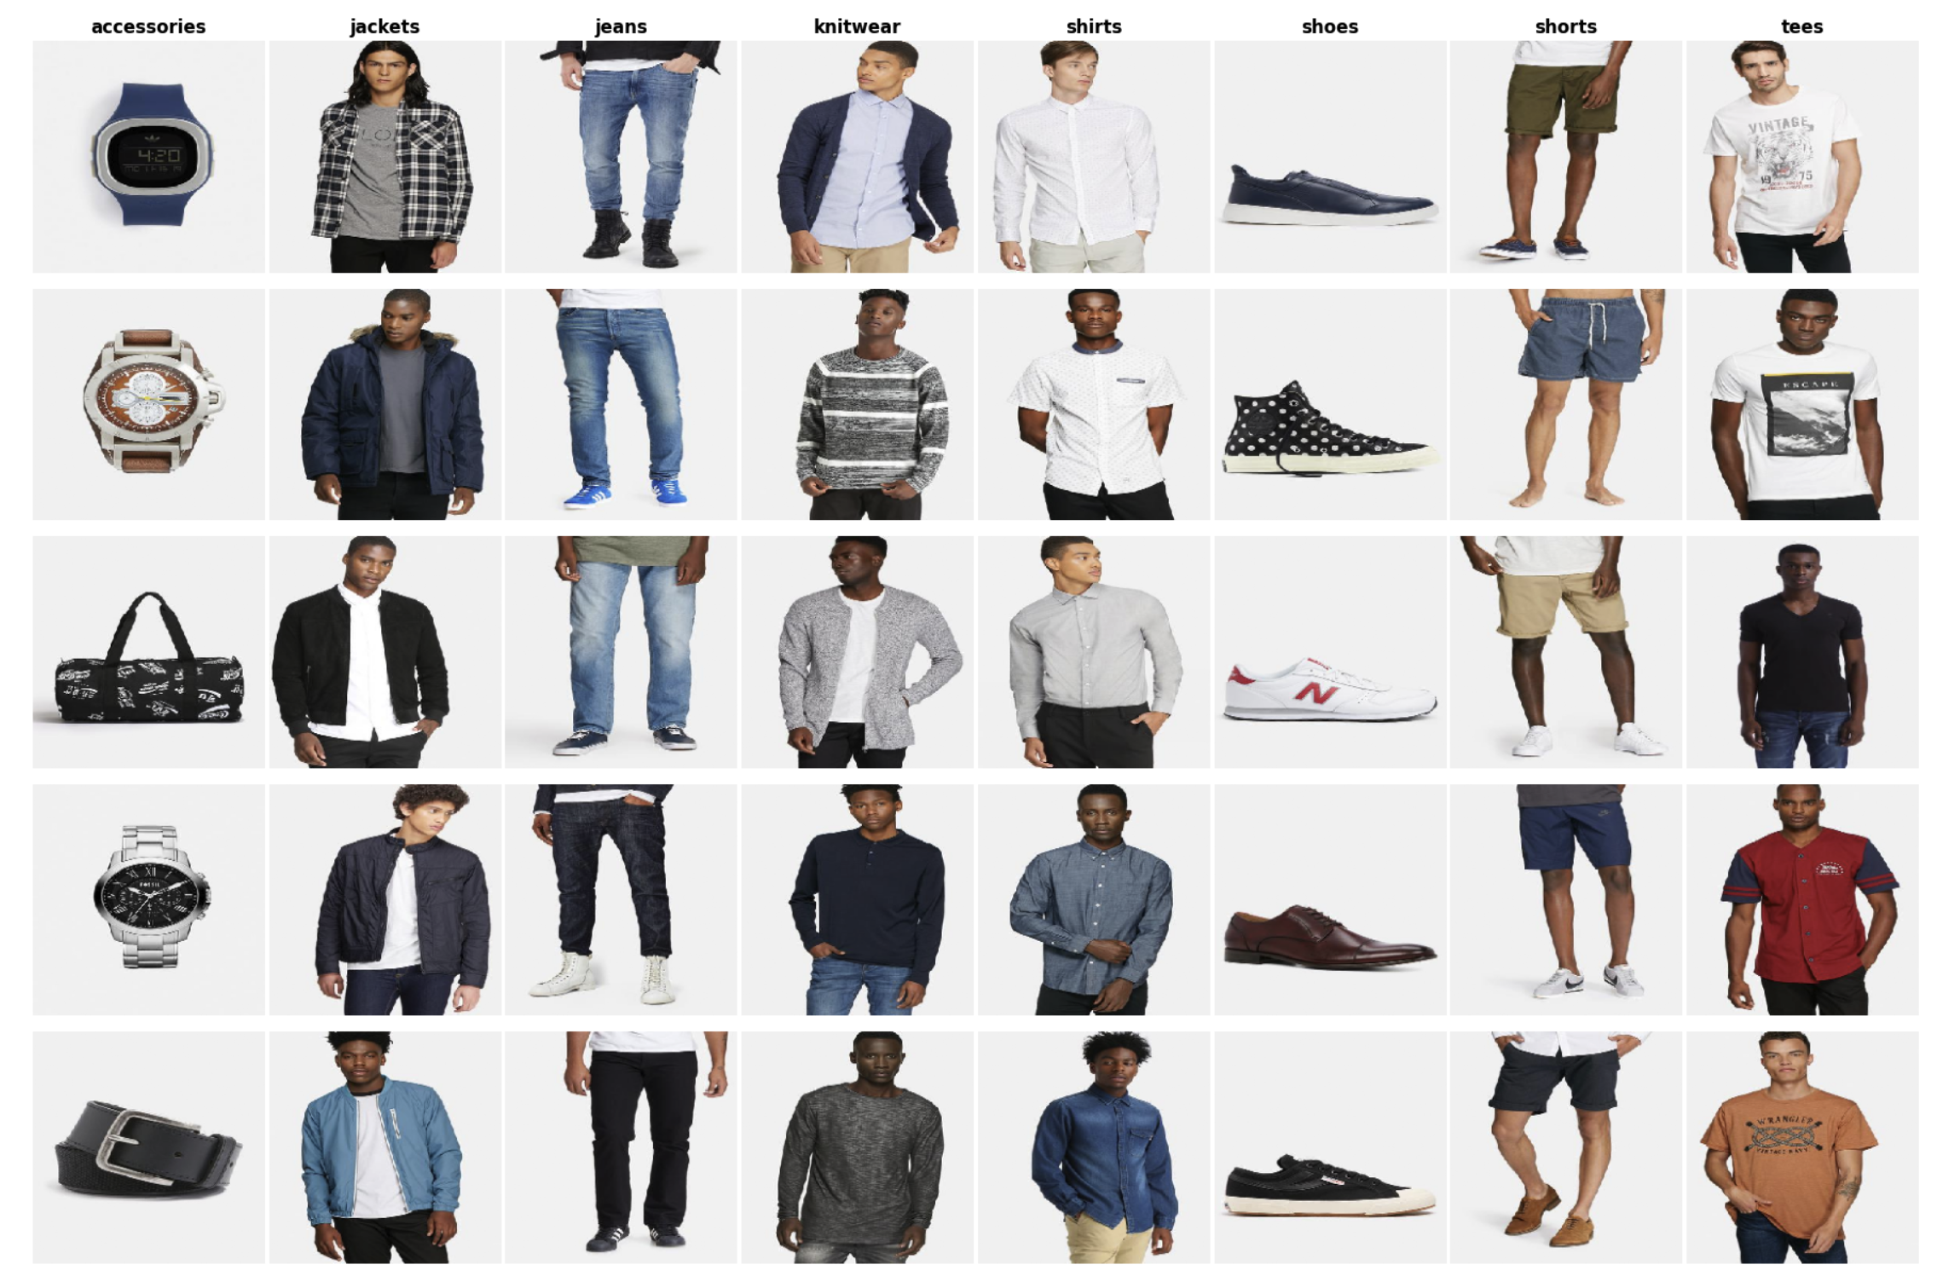

Slide 44
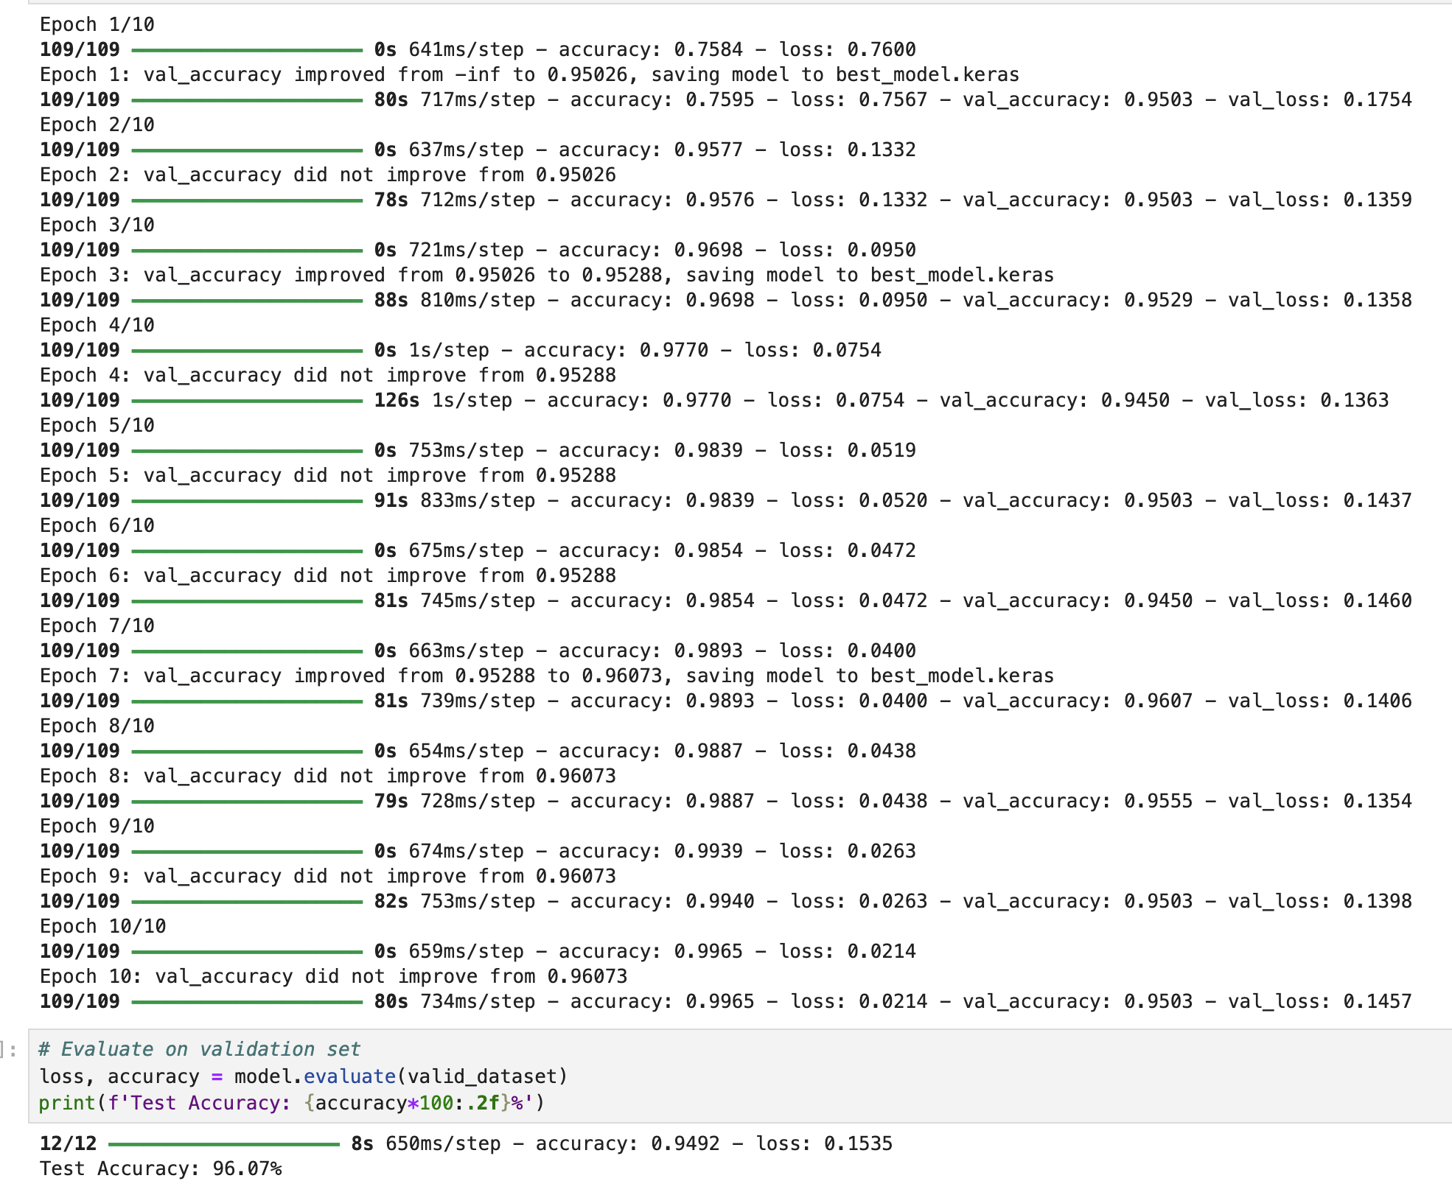

Slide 45
Embeddings
TODO

Slide 46
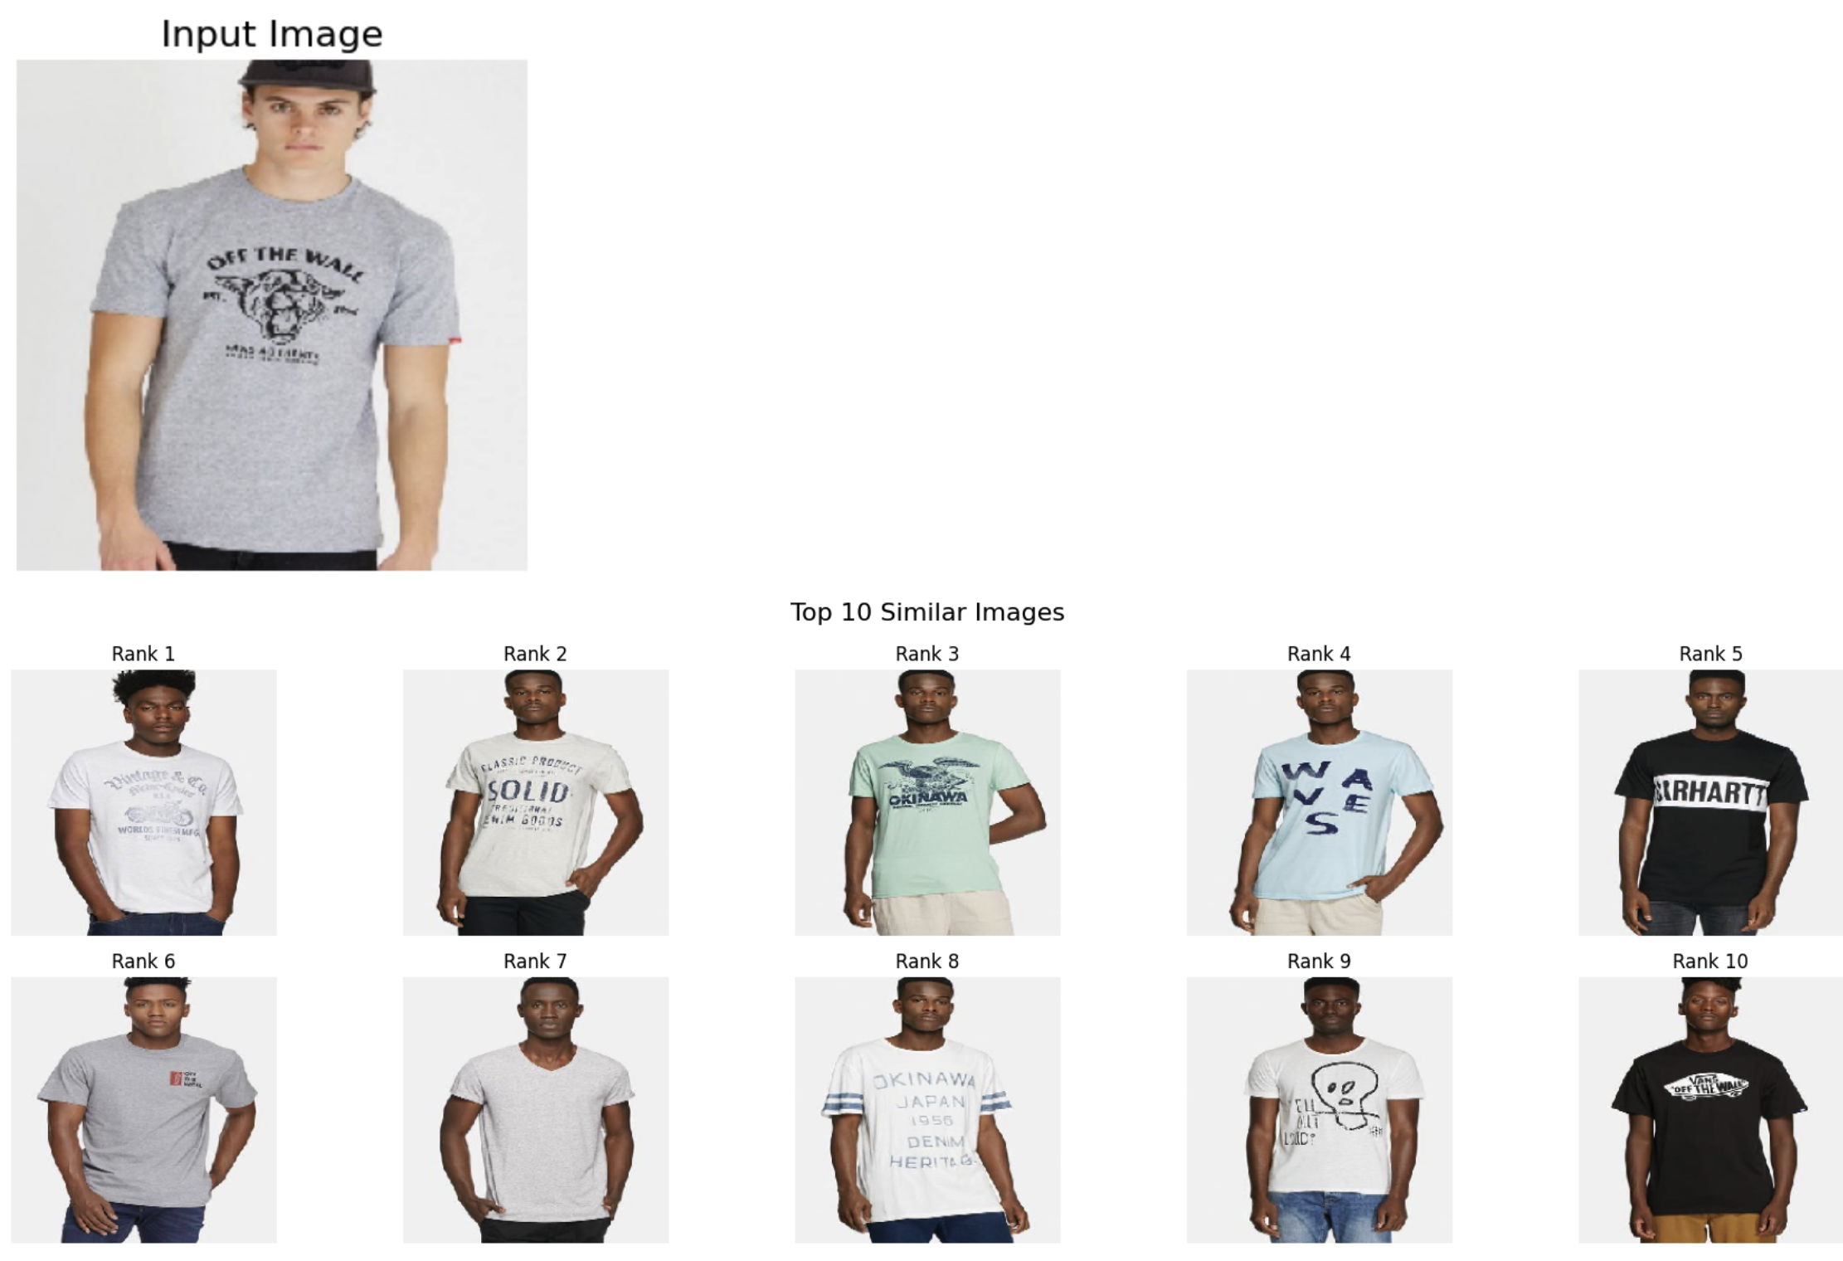

Slide 47
Jupyter Notebook
Object Detection.ipynb

Slide 48
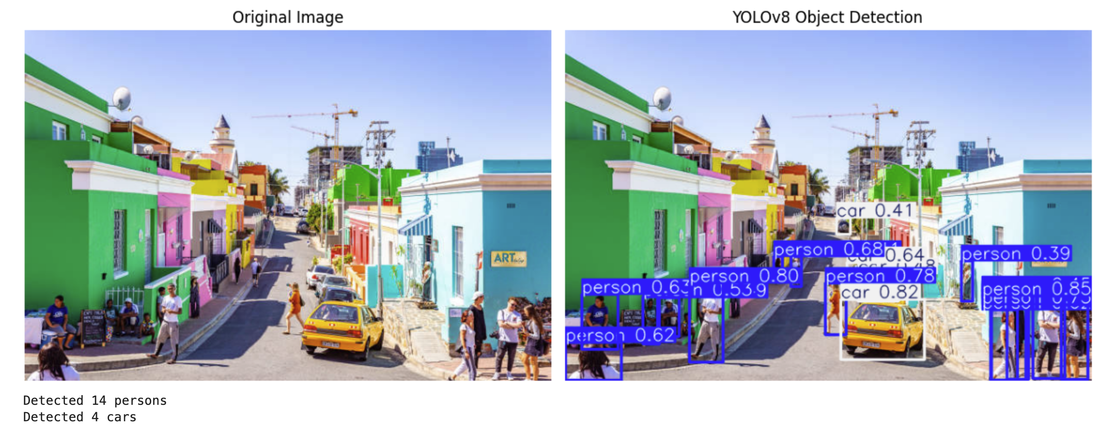

Slide 49
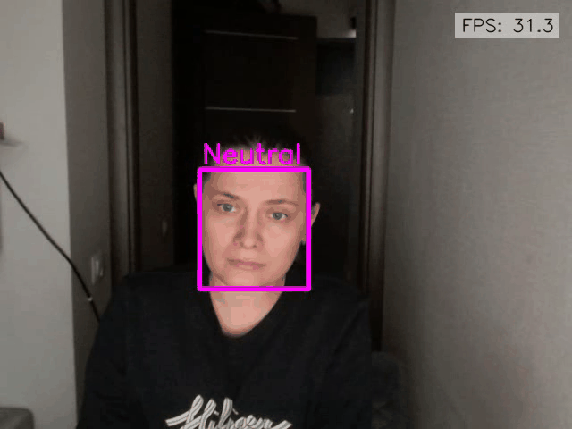
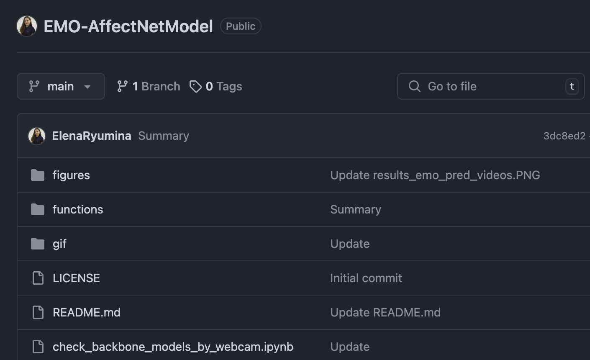
https://github.com/ElenaRyumina/EMO-AffectNetModel

Slide 50
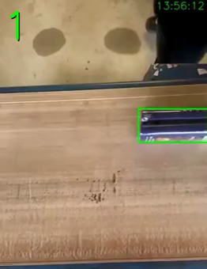

Slide 51

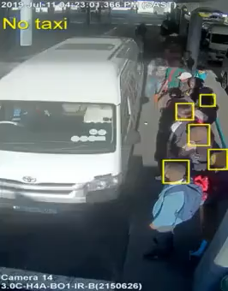

Slide 52
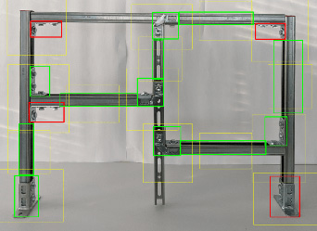

Slide 53
Jupyter Notebook
Segmentation.ipynb

Slide 54
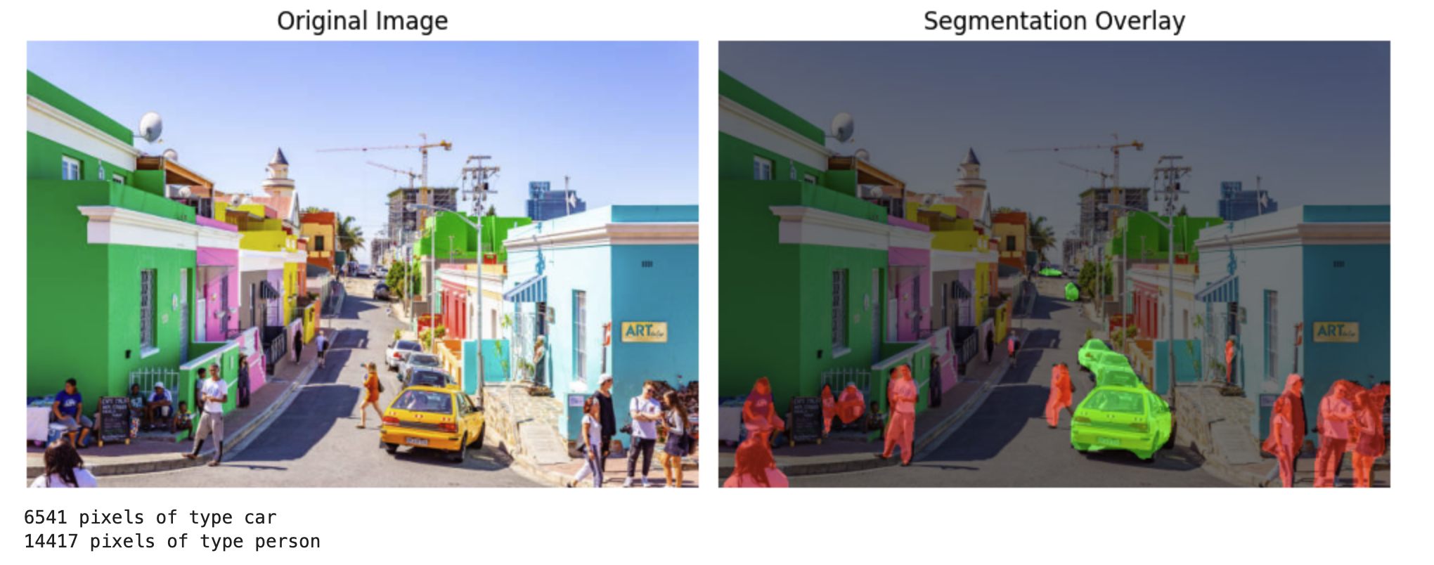

Slide 55
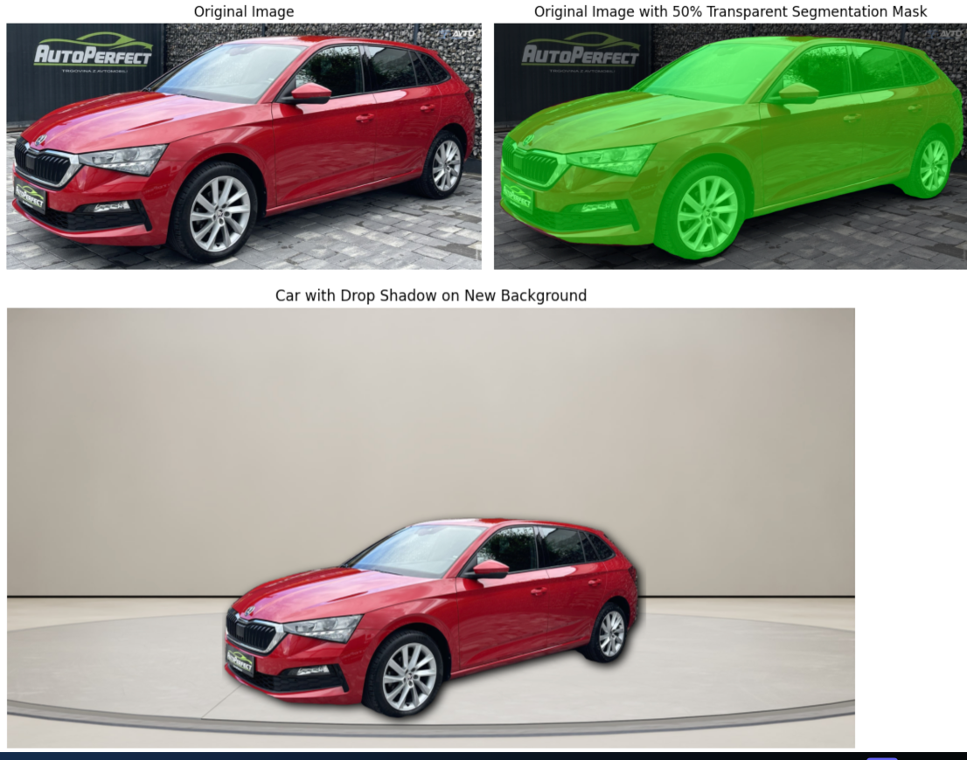

Slide 56
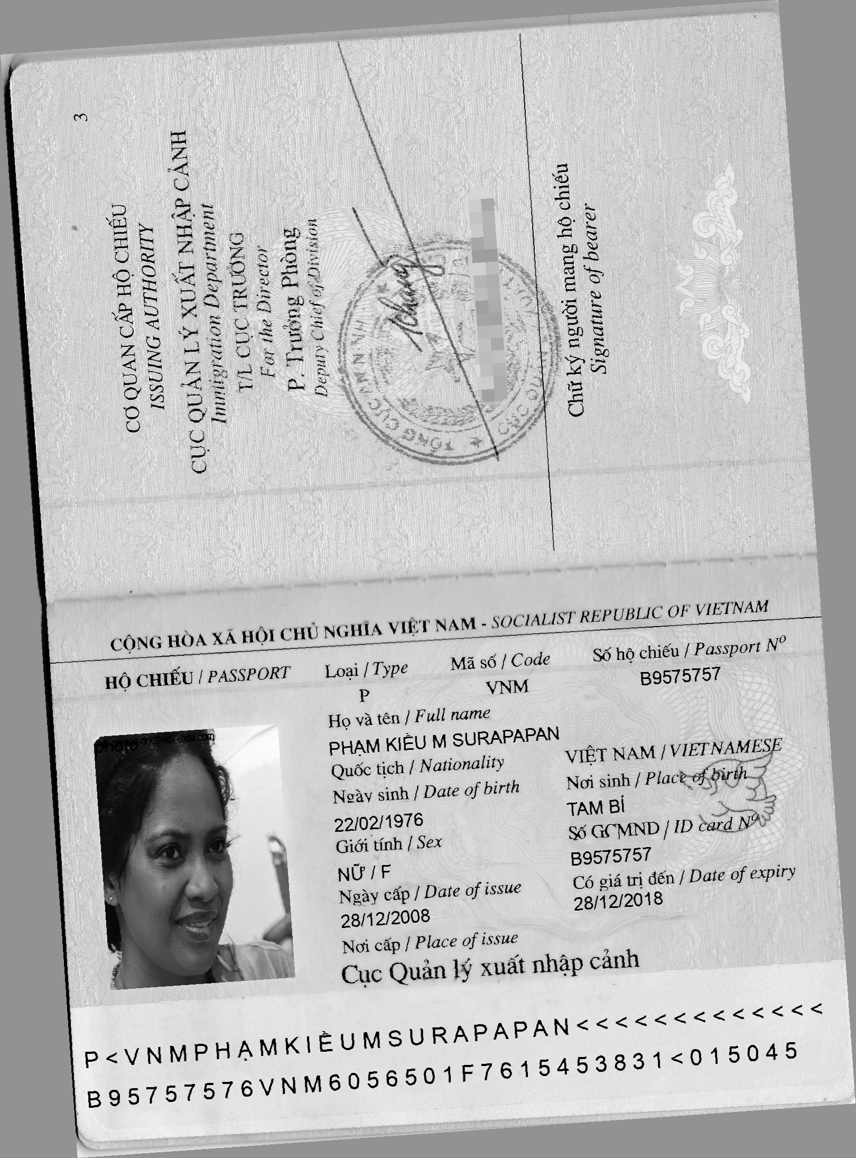
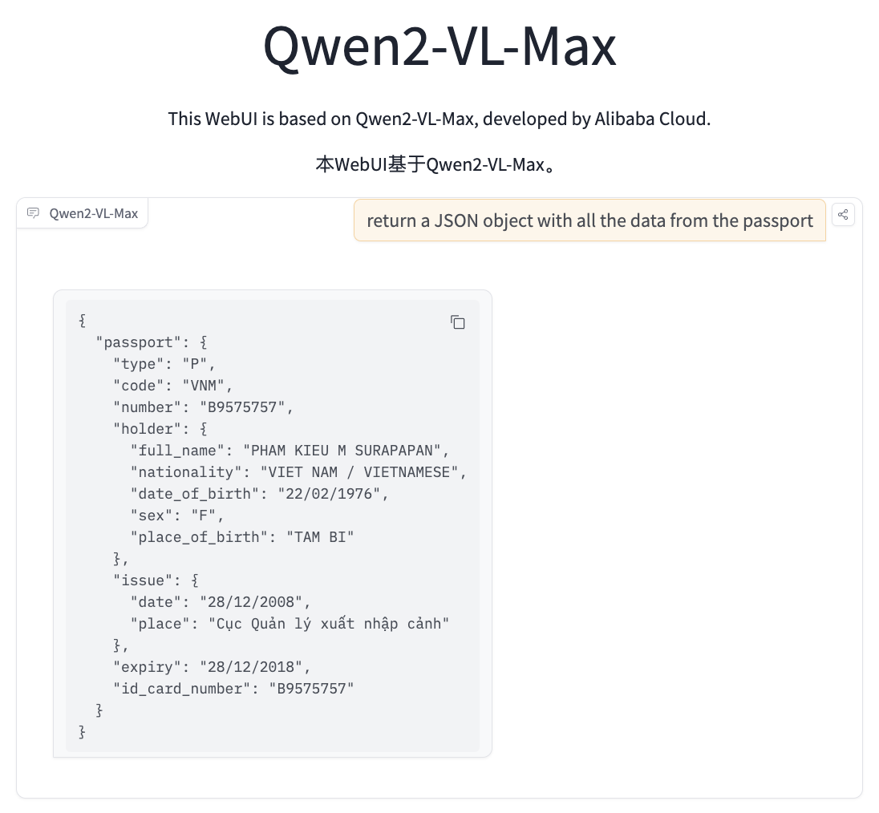

Slide 57
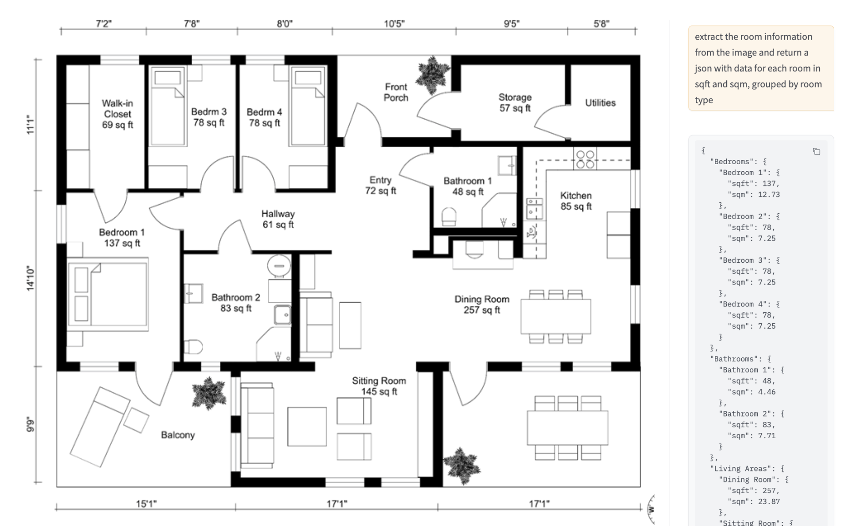

Slide 58
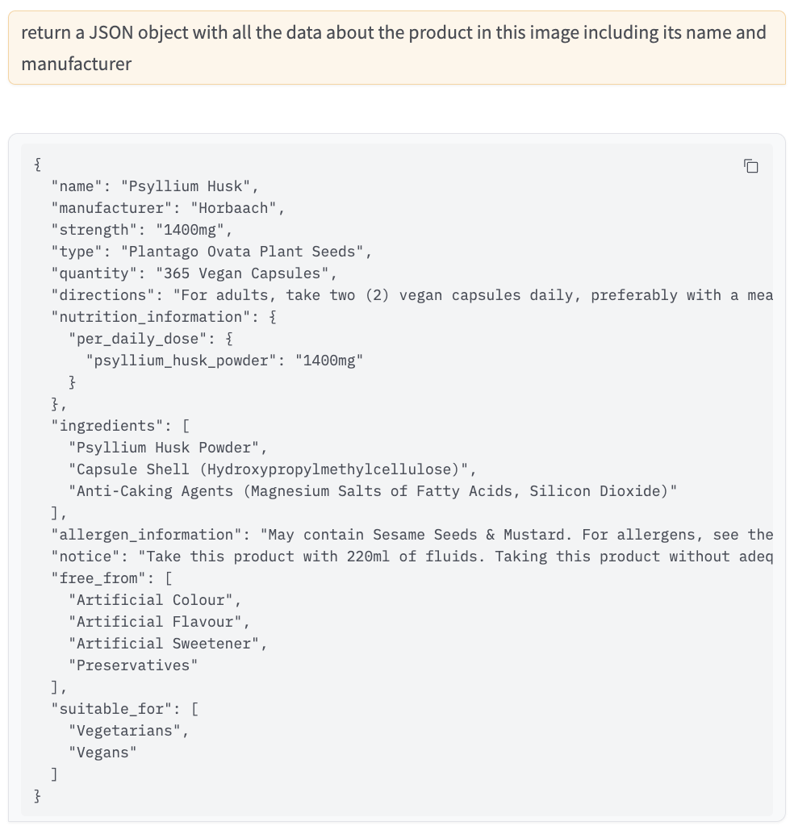


Slide 59
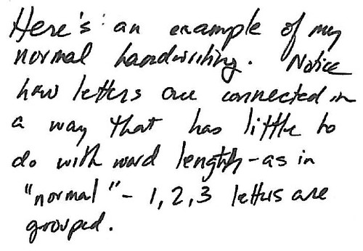
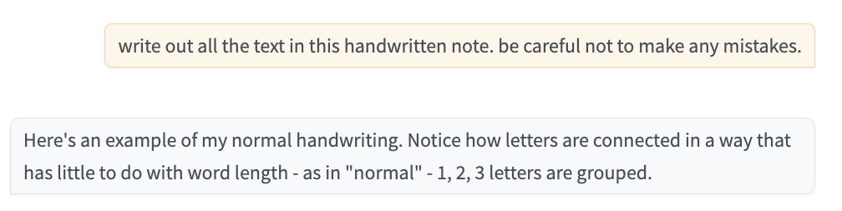

Slide 60
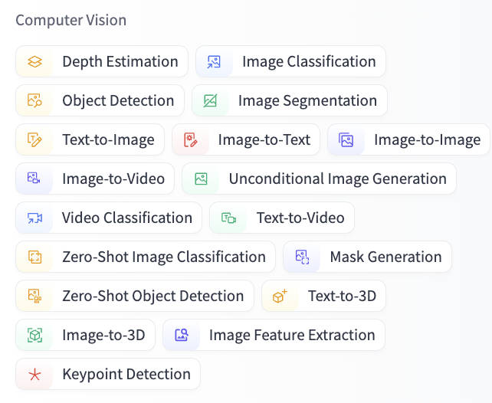

Slide 61
Speech Data

Slide 62
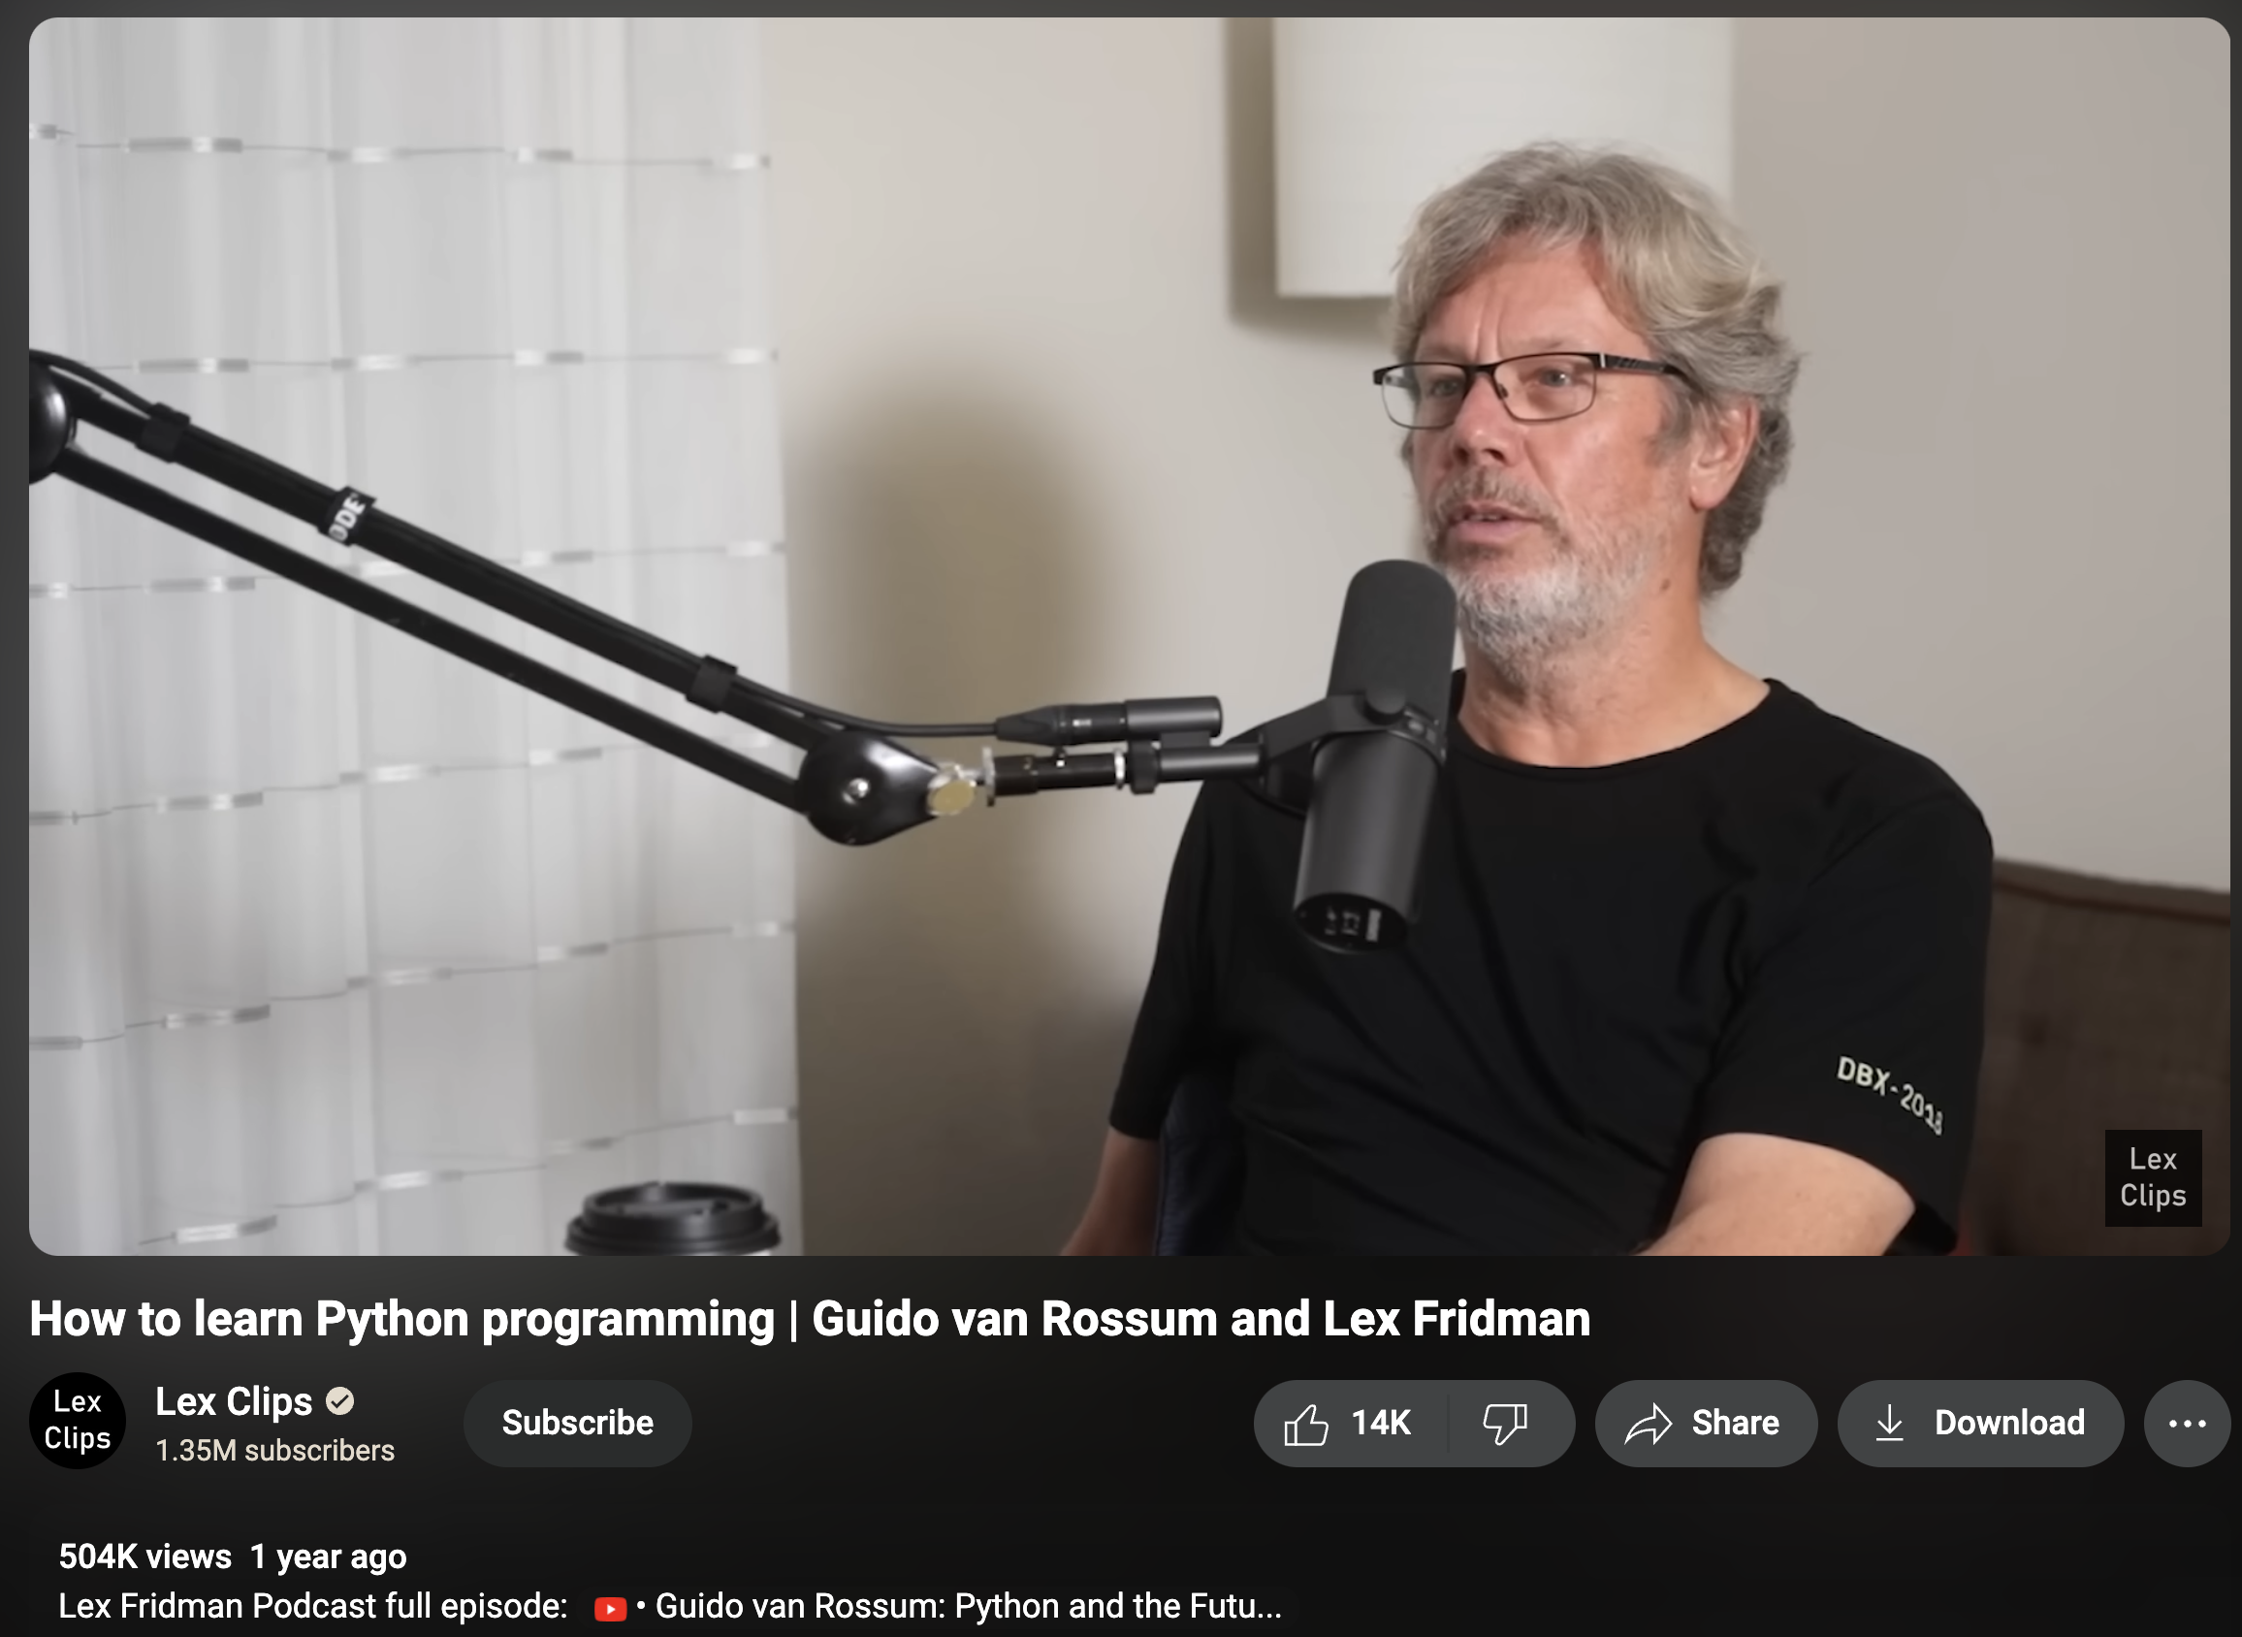

Slide 63
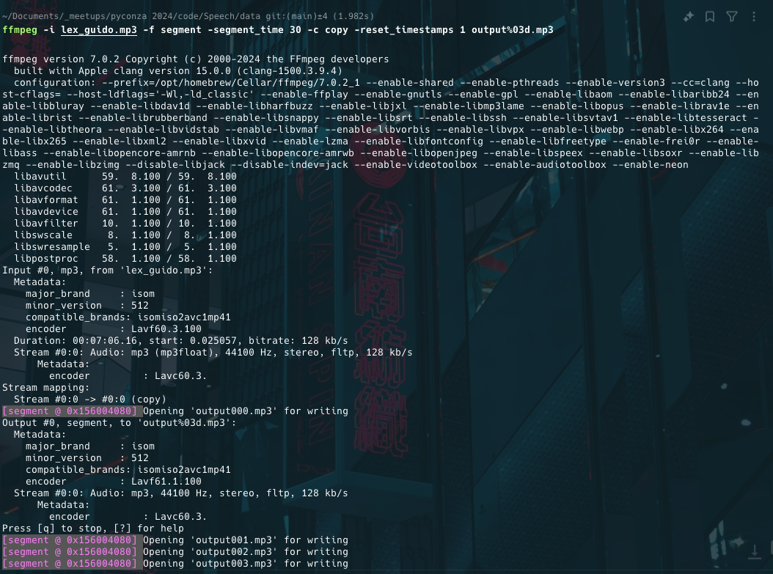

Slide 64
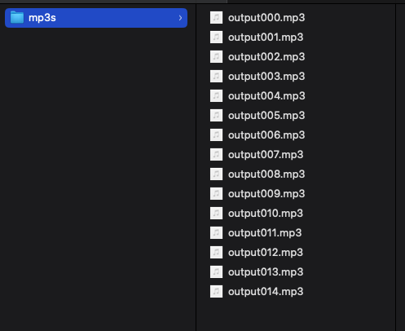

Slide 65
Jupyter Notebook
Transcribe.ipynb

Slide 66
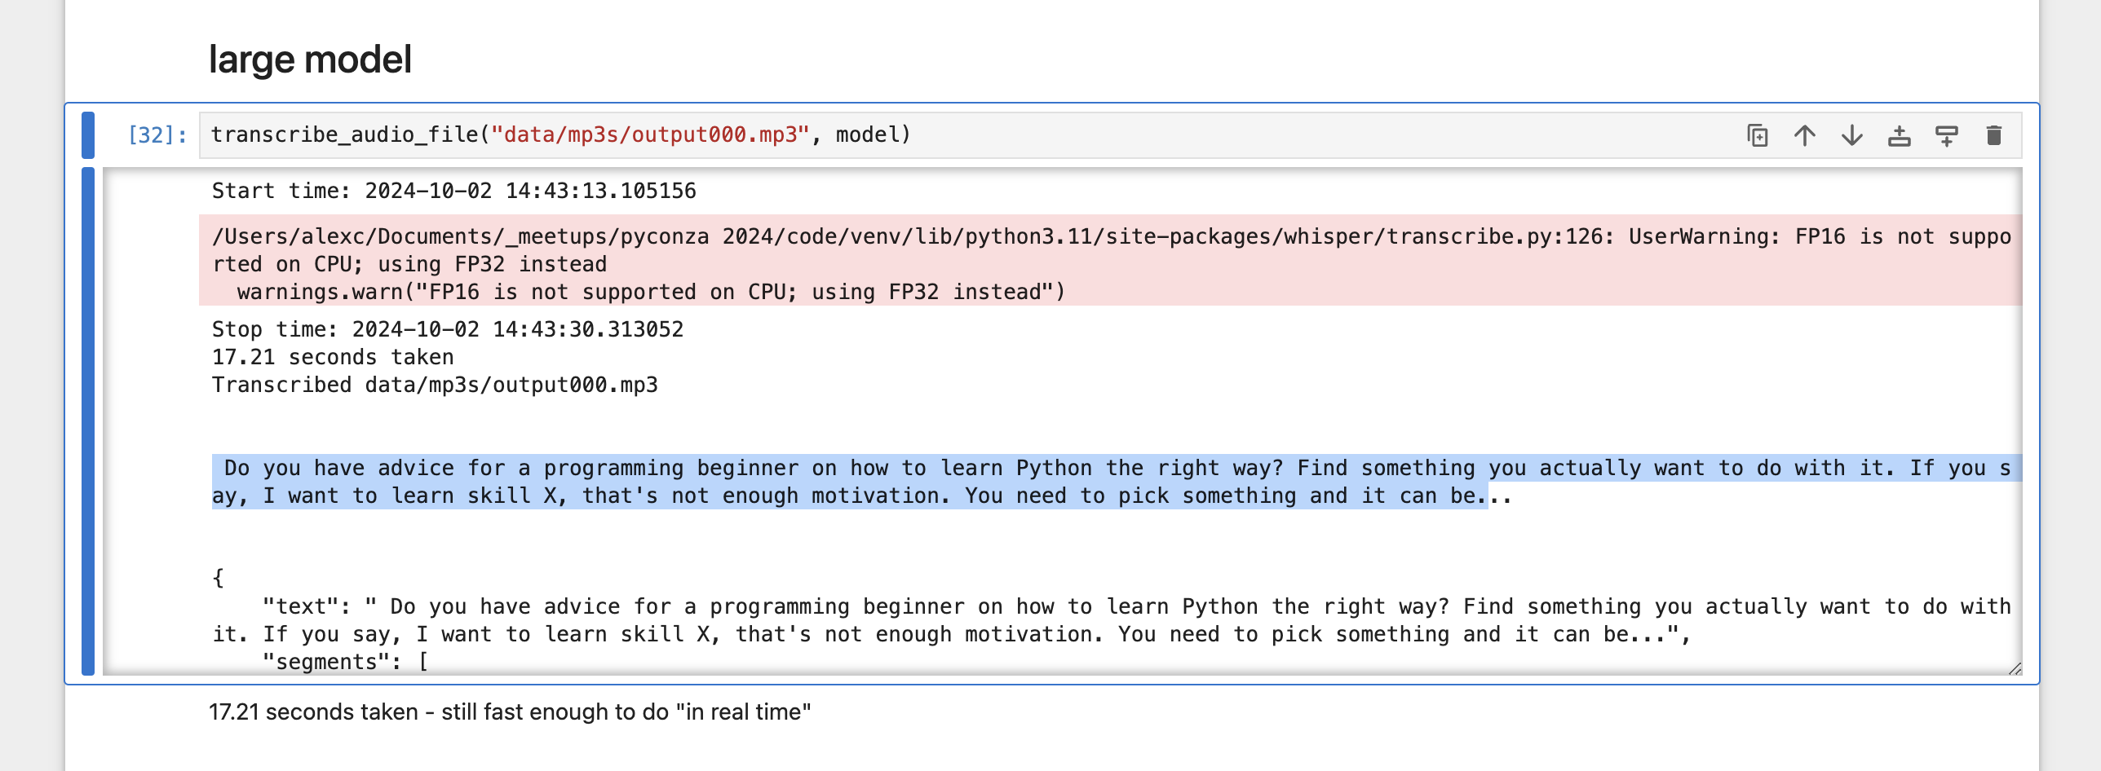

Slide 67
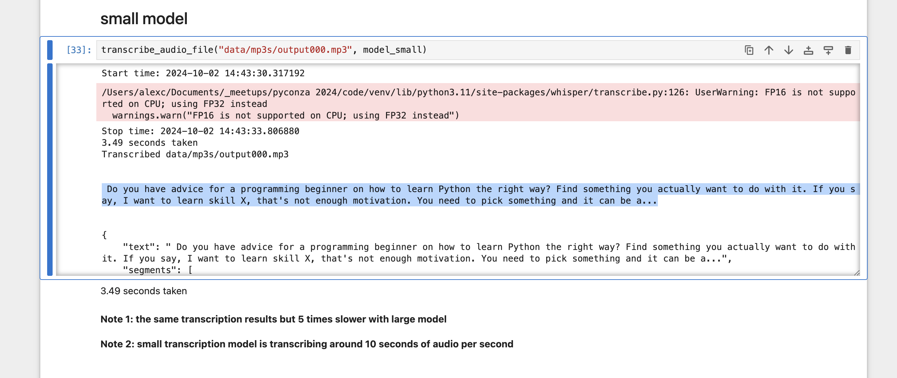

Slide 68
Jupyter Notebook
Speech emotion recognition.ipynb
https://github.com/mbamvianney/SPEECH-EMOTION-RECOGNITION-WITH-MACHINE-LEARNING

Slide 69
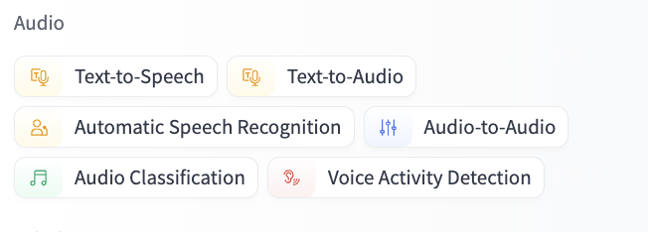

Slide 70
Text Data

Slide 71
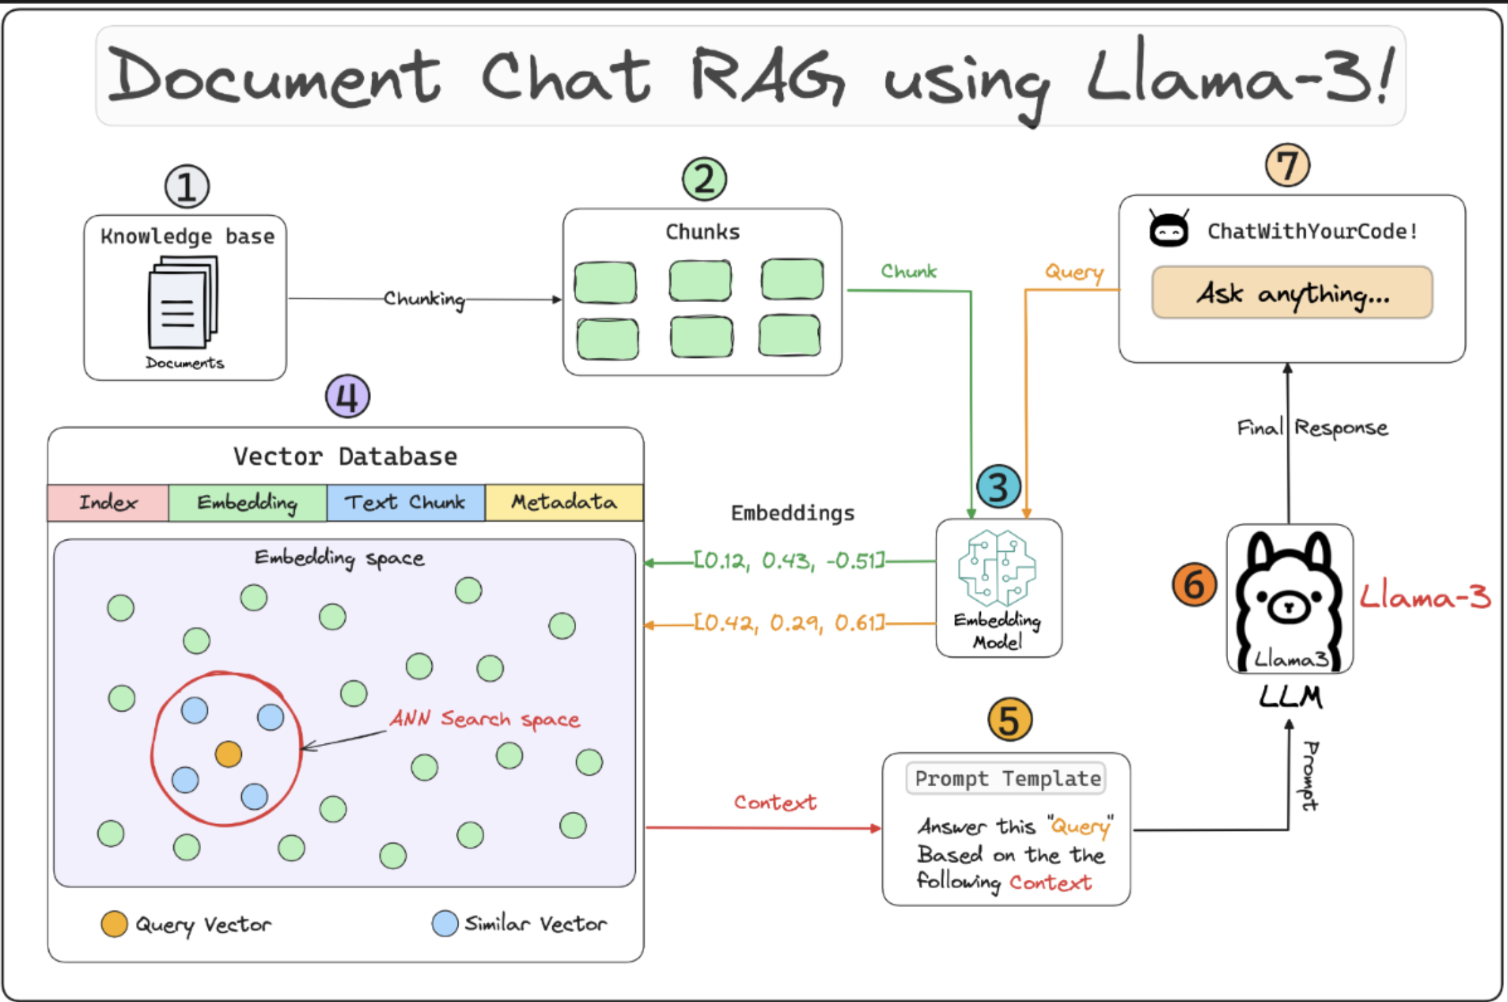
lightning.ai/lightning-ai/studios/rag-using-llama-3-2-by-meta-ai

Slide 72
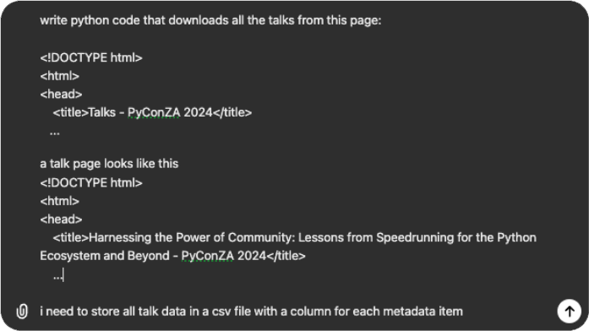
talks.html
talk.html

Slide 73
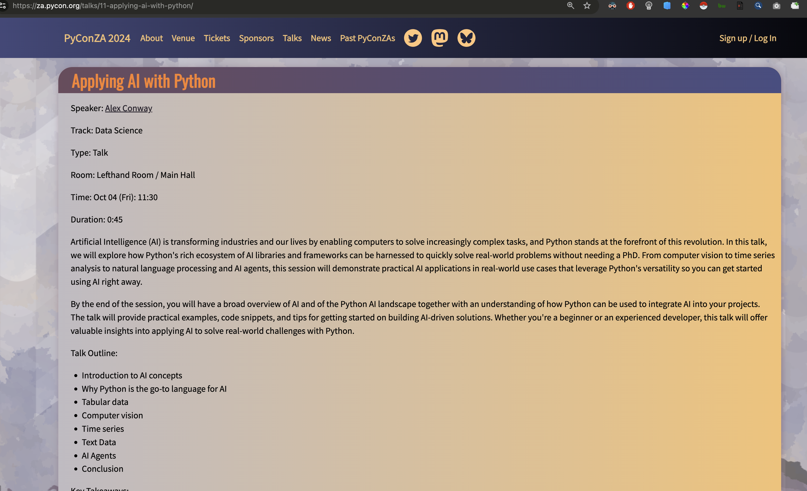

Slide 74
Jupyter Notebook
Scrape PyConZA2024.ipynb

Slide 75
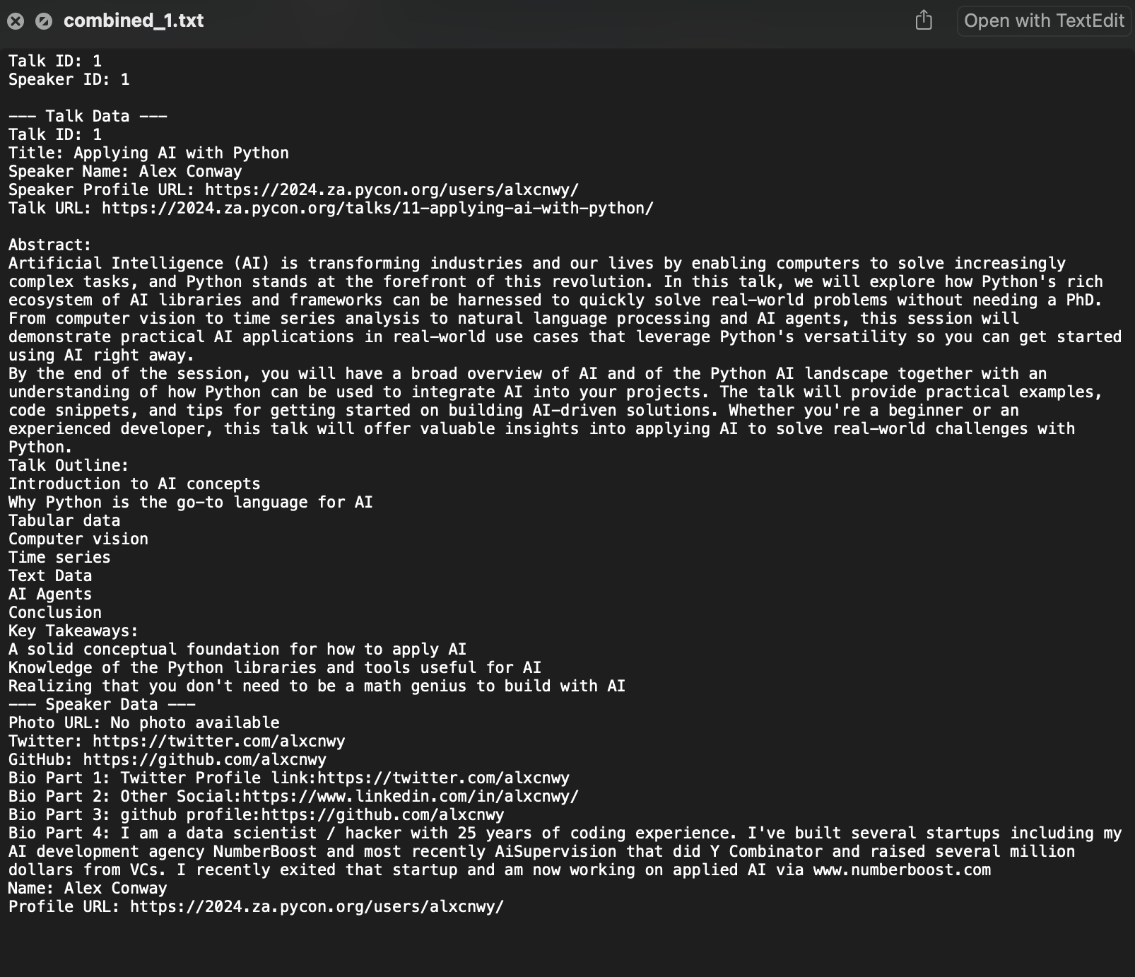

Slide 76
Jupyter Notebook
ETL – Load Documents into Database.ipynb

Slide 77
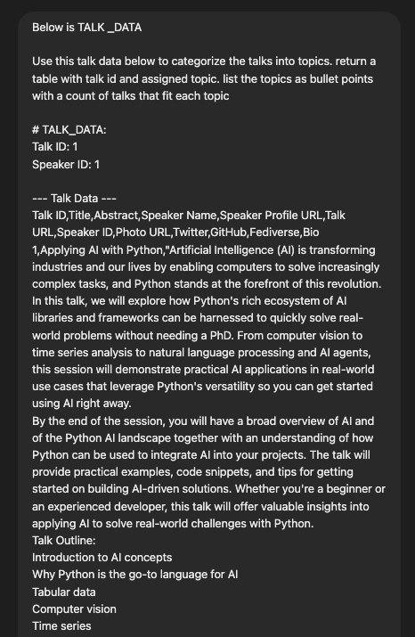
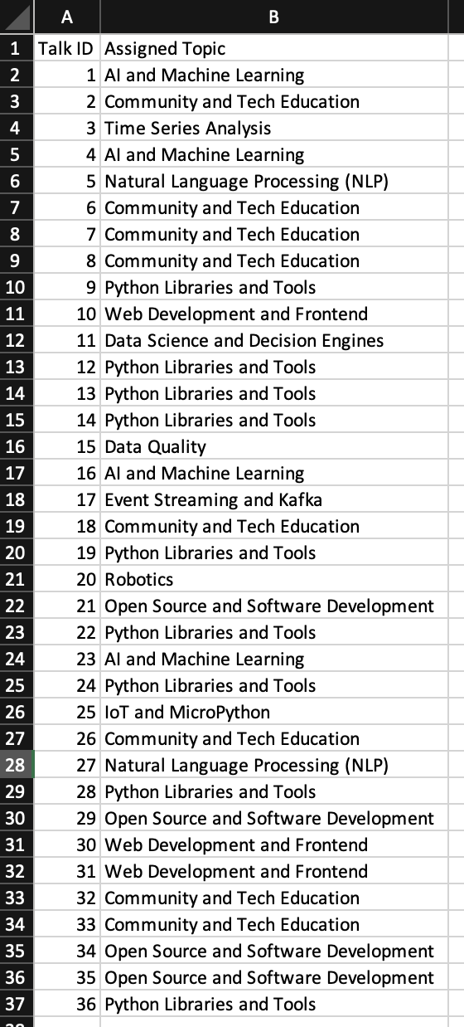

Slide 78
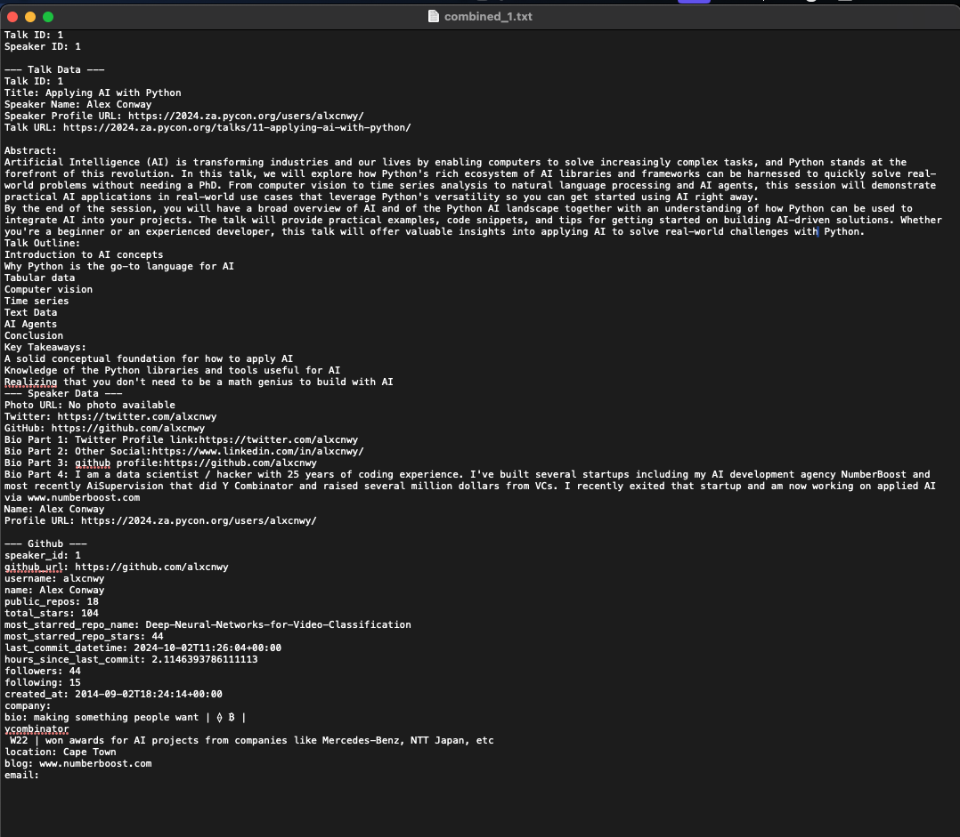

Slide 79


Slide 80


Slide 81
AI Agents

Slide 82


Slide 83
Remember the RAG model failed at this…

Slide 84


Slide 85


Slide 86


Slide 87
Jupyter Notebook
Agent.ipynb

Slide 88


Slide 89


Slide 90


Slide 91


Slide 92


Slide 93

Wrong!

Slide 94

Correct!

Slide 95


Slide 96


Slide 98


Slide 99
Conclusion

Slide 100


Slide 102
def ai_model(input):
#
# algorithms f(input) = output
#
return output

Slide 103



def ai_model(input):
#
#
#
return output

Slide 104
Thank You!
Alex Conway
alex@numberboost.com
x.com/alxcnwy

